Slide 1




Natural Language to SQL: State of the Art and Open Problems
Yuyu Luo, Nan Tang
HKUST(GZ)
Guoliang Li
Tsinghua University
Ju Fan
Renmin Univ. of China
Chengliang Chai
Beijing Institute of Tech.
https://github.com/HKUSTDial/NL2SQL_Handbook
https://github.com/HKUSTDial/awesome-data-agents
yuyuluo@hkust-gz.edu.cn

Slide 2


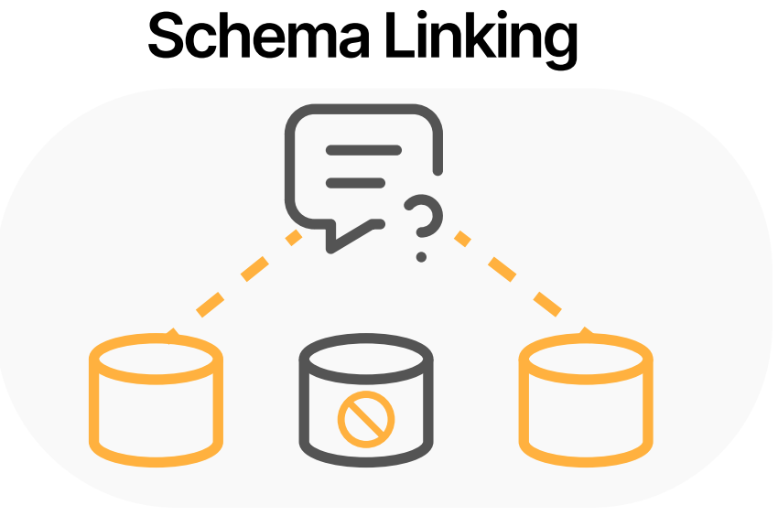

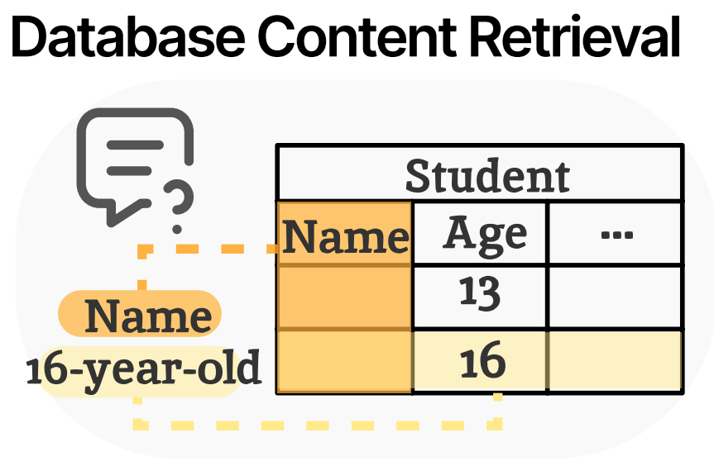
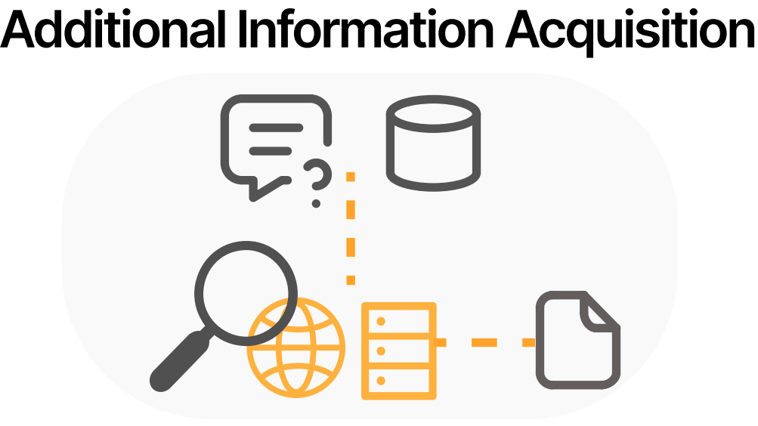
NL2SQL (Text-to-SQL): Bridges Humans and Databases
Who are the three youngest winners across all matches? And their ranks?
NL Query
DB Information
Users
NL2SQL Model
SQL
SELECT winner_name, winner_rank FROM matches ORDER BY winner_age LIMIT 3
Notes:
How can a user query a database using natural language? Imagine a user asks, “Who are the three youngest winners across all matches, and what are their ranks?” A NL2SQL system takes this natural language (NL) query from the user and translates it into the corresponding SQL query that the database can execute. The database then executes this SQL and returns the results to the user. The interface thereby bridges humans and databases: the human expresses their information need in everyday language, and the system generates the precise database query to retrieve the answer. This is incredibly valuable for democratizing access to data – allowing people who aren’t SQL experts to still leverage the full power of databases.
However, building an accurate NL2SQL system is far from trivial.

Slide 3
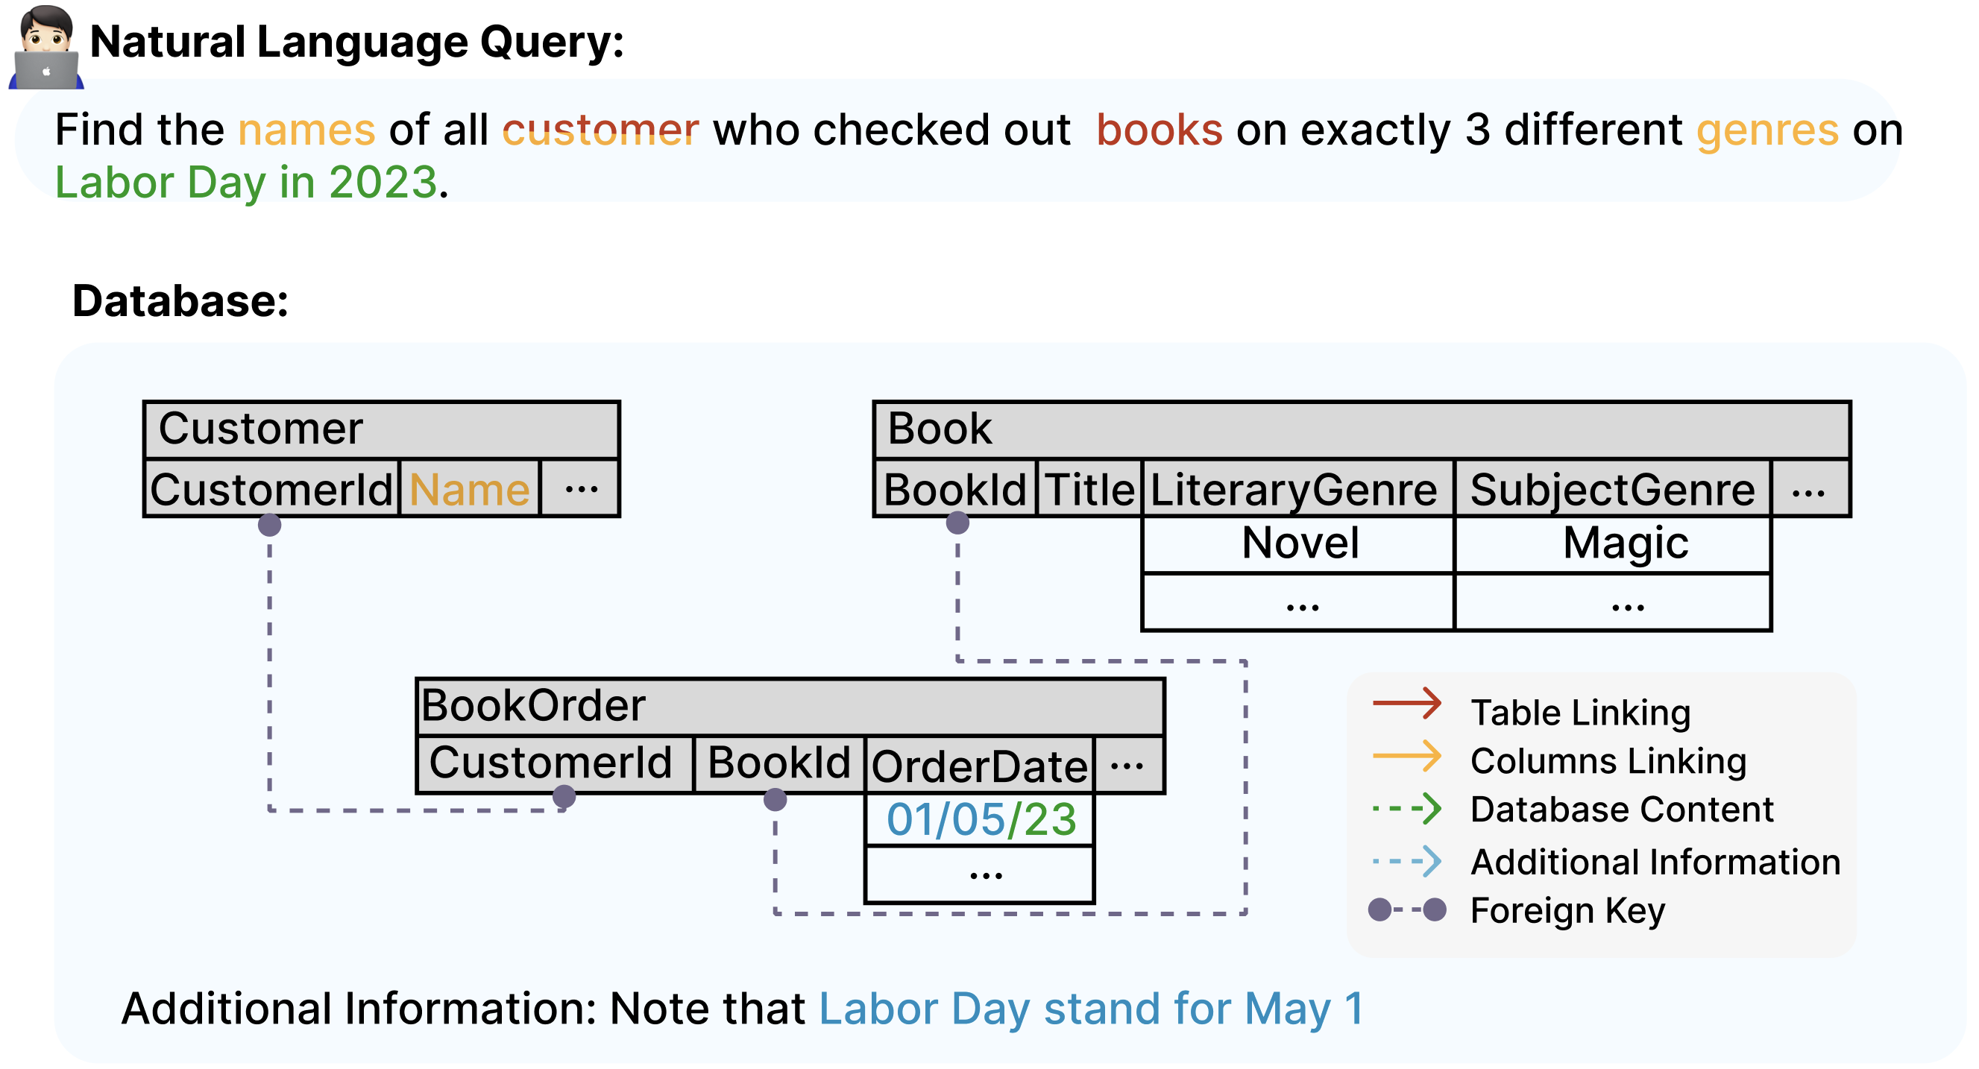
Task Challenges
C1. Ambiguous NL Query
C2. Requiring Domain Knowledge
C3. Complex Database Schema
C1
C3
C2

Slide 4
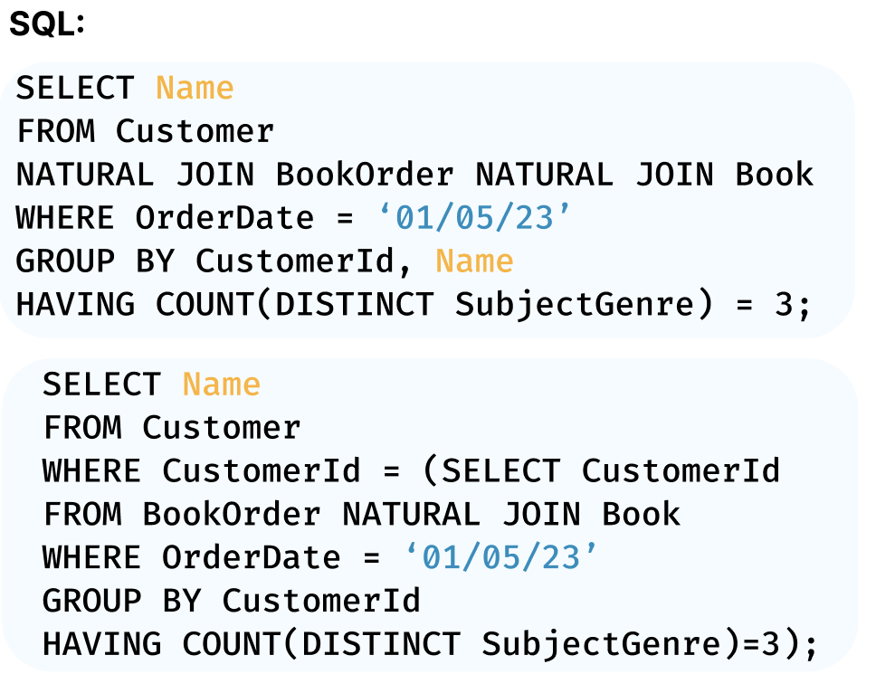
Task Challenges
C1. Ambiguous NL Query
C2. Requiring Domain Knowledge
C3. Complex Database Schema
C4. Multiple Possible SQL Queries
C1
C3
LiteraryGenre
C1
C2
LiteraryGenre
3

Slide 5
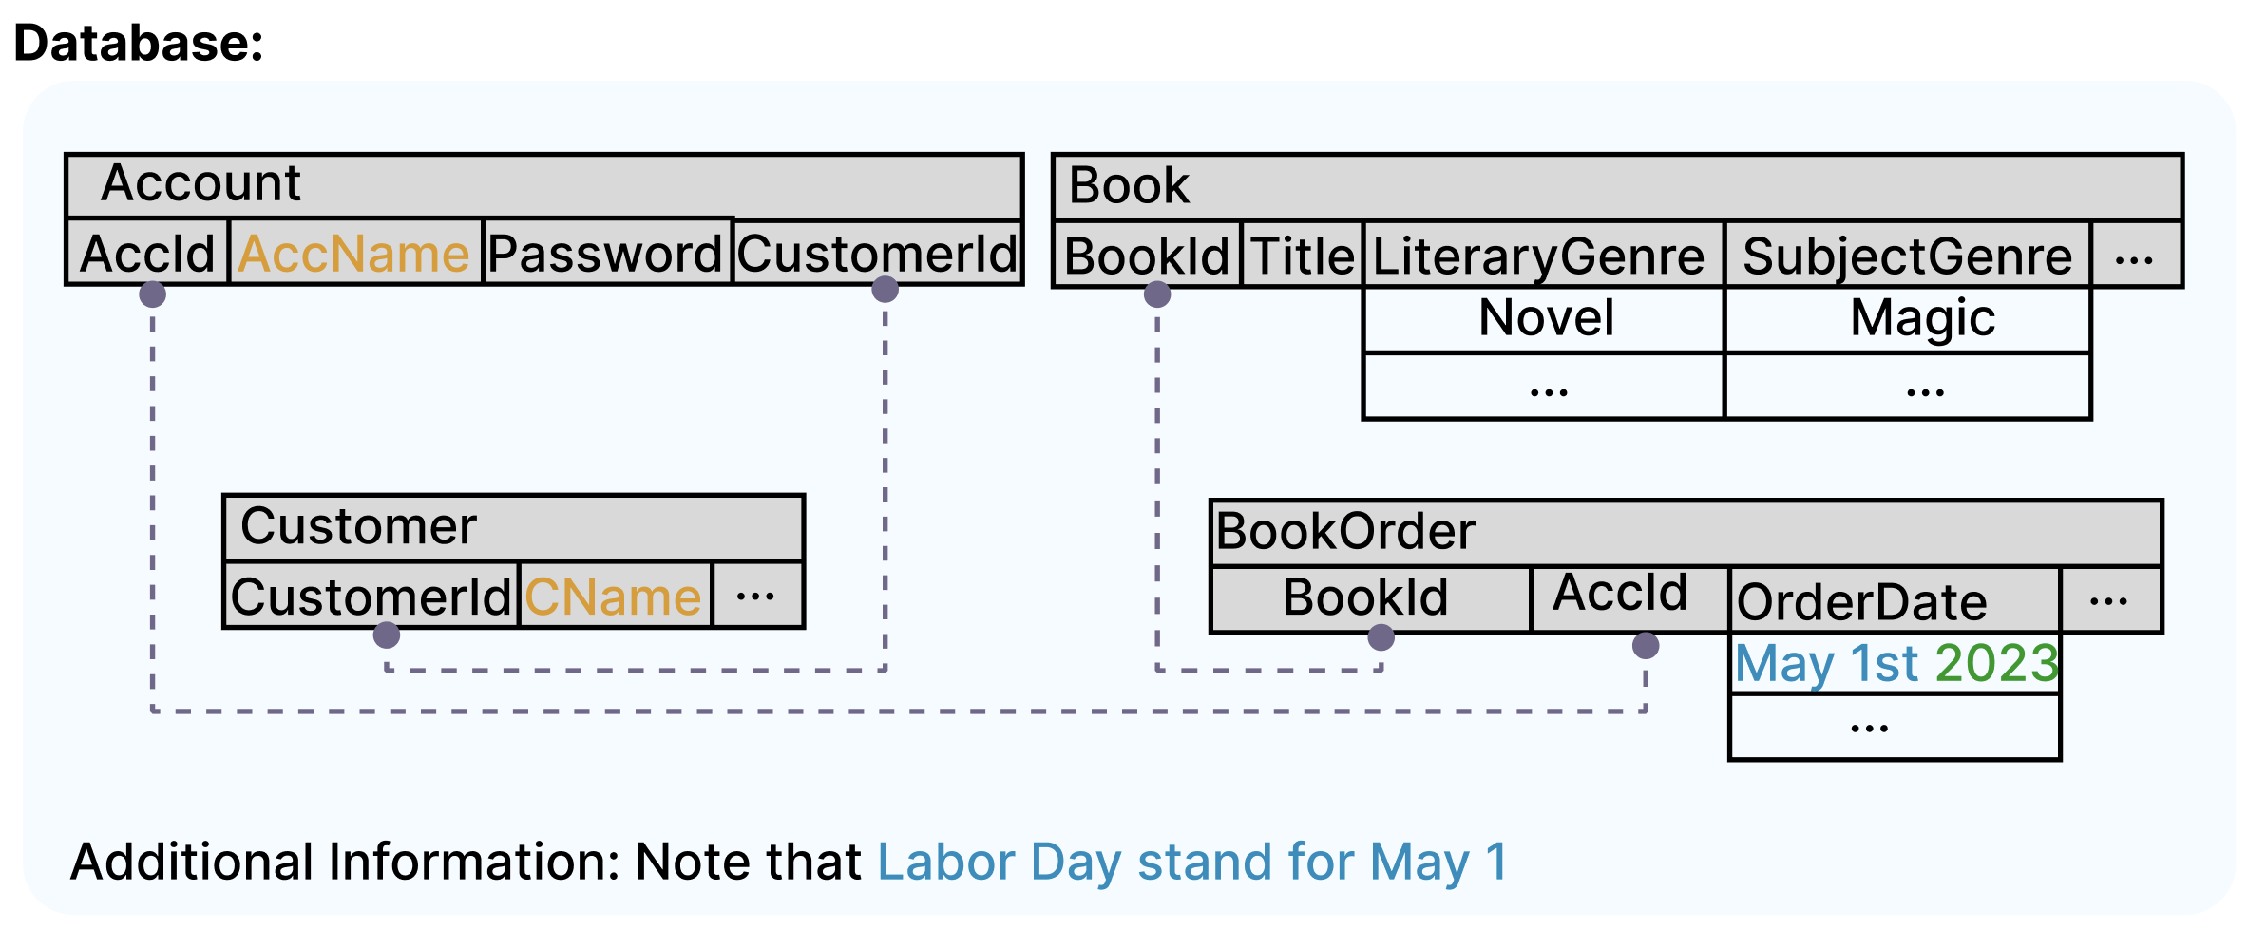
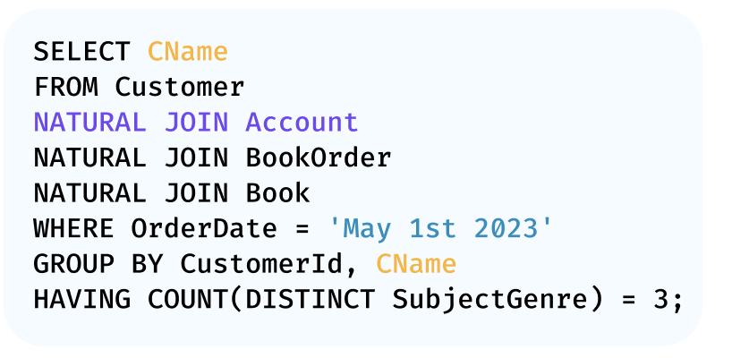
Task Challenges
C1. Ambiguous NL Query
C2. Requiring Domain Knowledge
C3. Complex Database Schema
C4. Multiple Possible SQL Queries
C5. Database Schema Dependency
C6. Database Domain Adaption
4

Slide 6
Challenges
NL2SQL Challenges
Complex Database and Dirty Content
NL2SQL Translation
Technical Challenges in Developing NL2SQL Solutions
Uncertain NL Query
Lexical Ambiguity
Syntactic Ambiguity
Complex Relationships Among Tables
Under-specification
User Mistakes
Ambiguity in Attributes and Values
Domain-Specific Schema Designs
Large and Dirty Database Values
Free-form NL vs. Constrained and Formal SQL
Cost-effective Solution
SQL Efficiency
Model Efficiency
Trustworthiness and Reliability
Database Schema Dependency
Multiple Possible SQL Queries
Data Privacy
Insufficient and Noisy Training Data
Task Challenges
(inherent challenges)

Slide 7
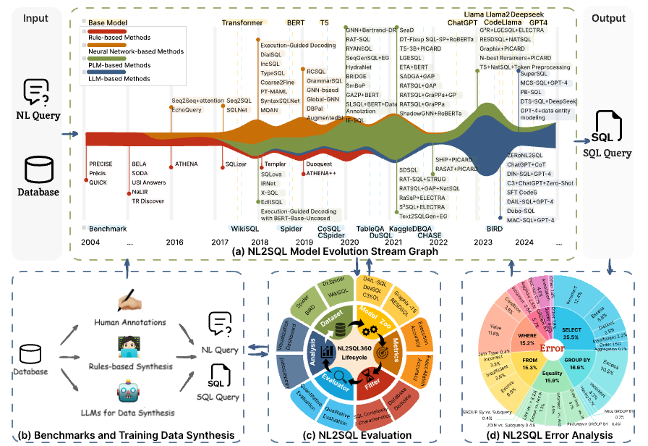

Slide 8
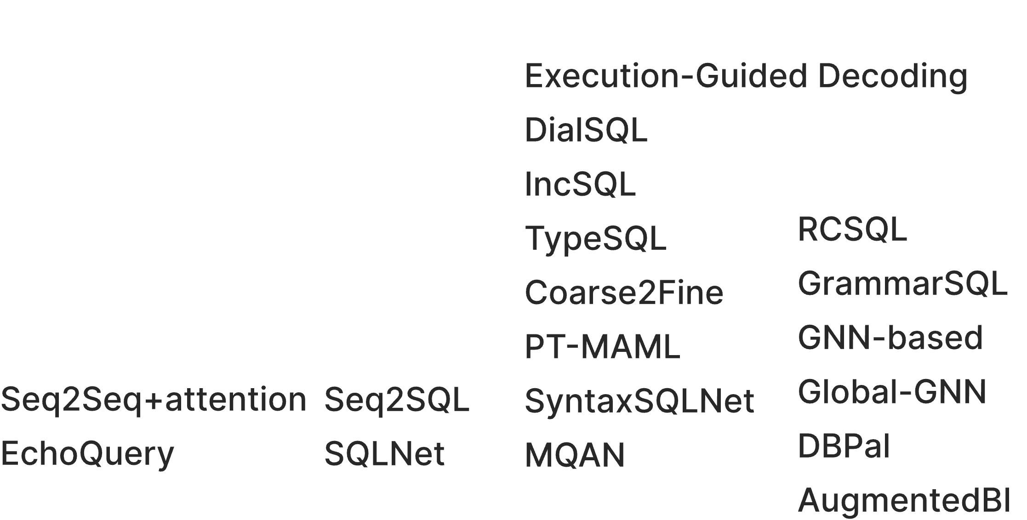
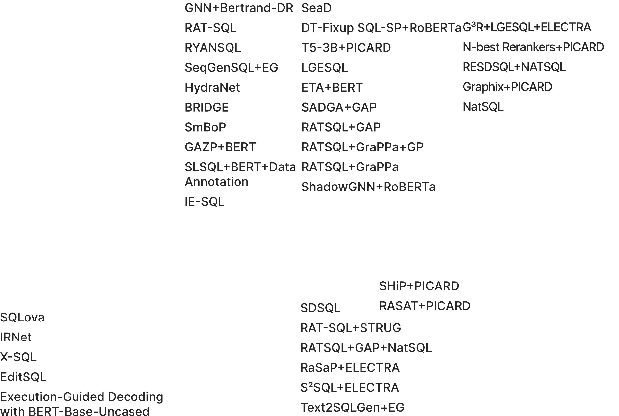
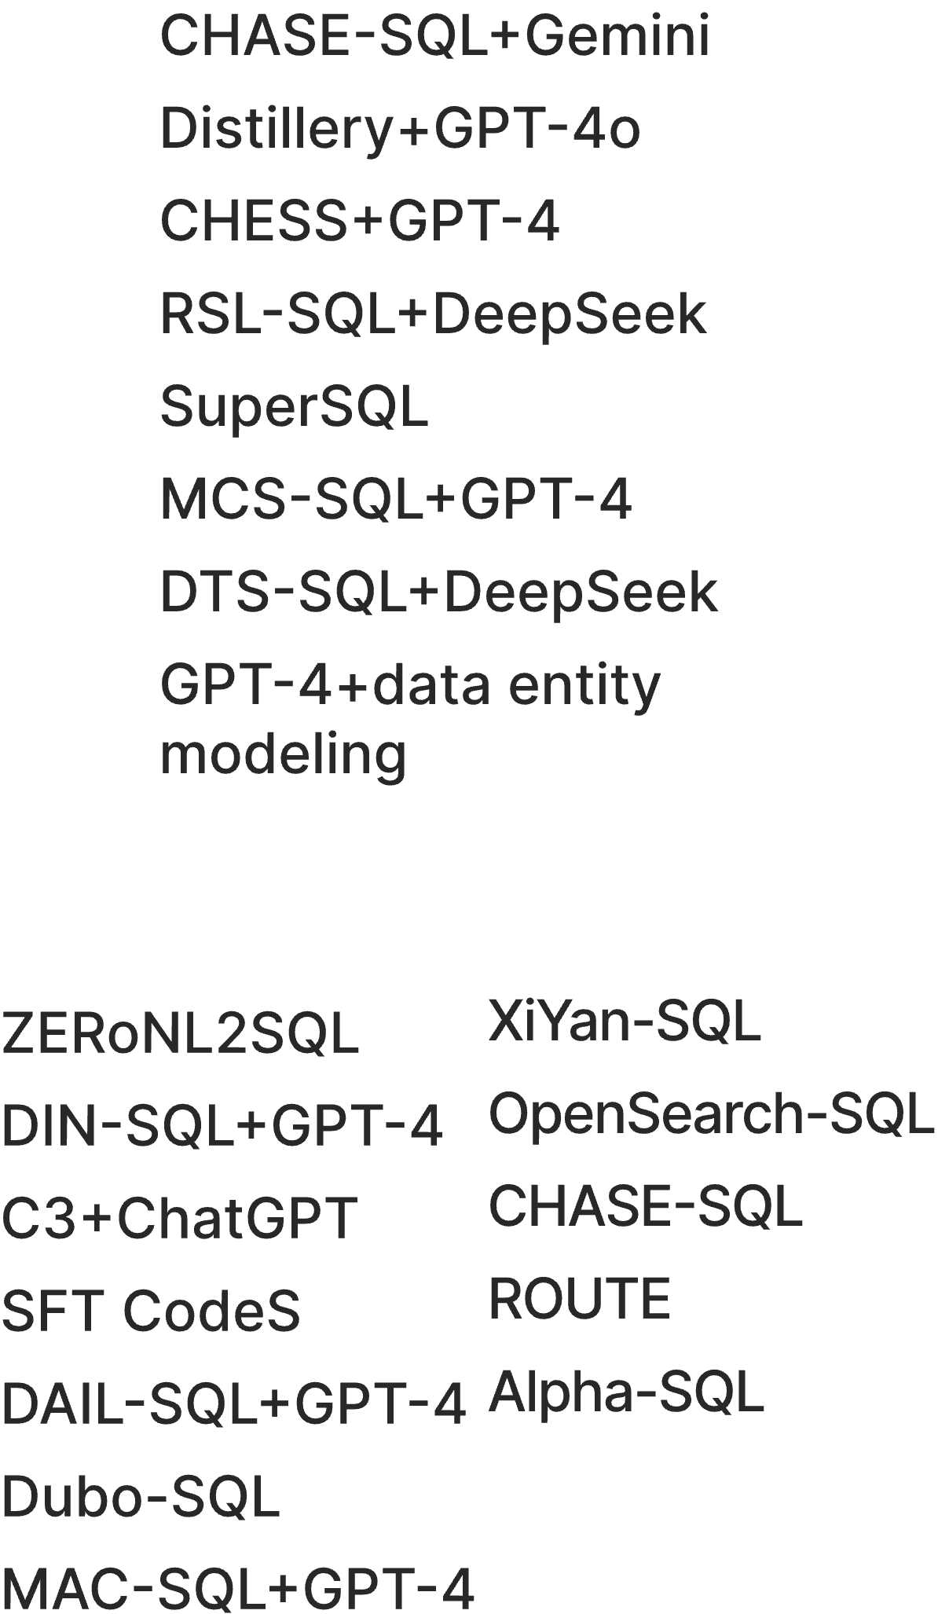
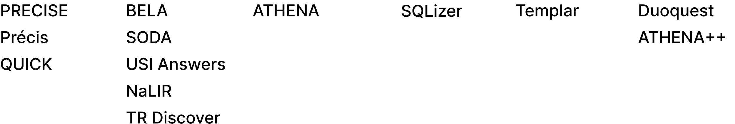
Where Are We?
https://github.com/HKUSTDial/NL2SQL_Handbook
Notes:
1. Rule-based approaches (shown in red) dominated initially; these systems relied heavily on handcrafted rules and templates; As we moved toward 2016–2018, the advent of deep learning shifted the community toward Neural Network-based methods (orange), leveraging architectures like Seq2Seq with attention mechanisms and transformers; With the arrival of pre-trained language models such as BERT and T5 around 2019, we entered the era of PLM-based methods (green), significantly improving the semantic understanding and generalization capabilities of NL2SQL systems.; With the arrival of pre-trained language models such as BERT and T5 around 2019, we entered the era of PLM-based methods (green), significantly improving the semantic understanding and generalization capabilities of NL2SQL systems.;

Slide 9
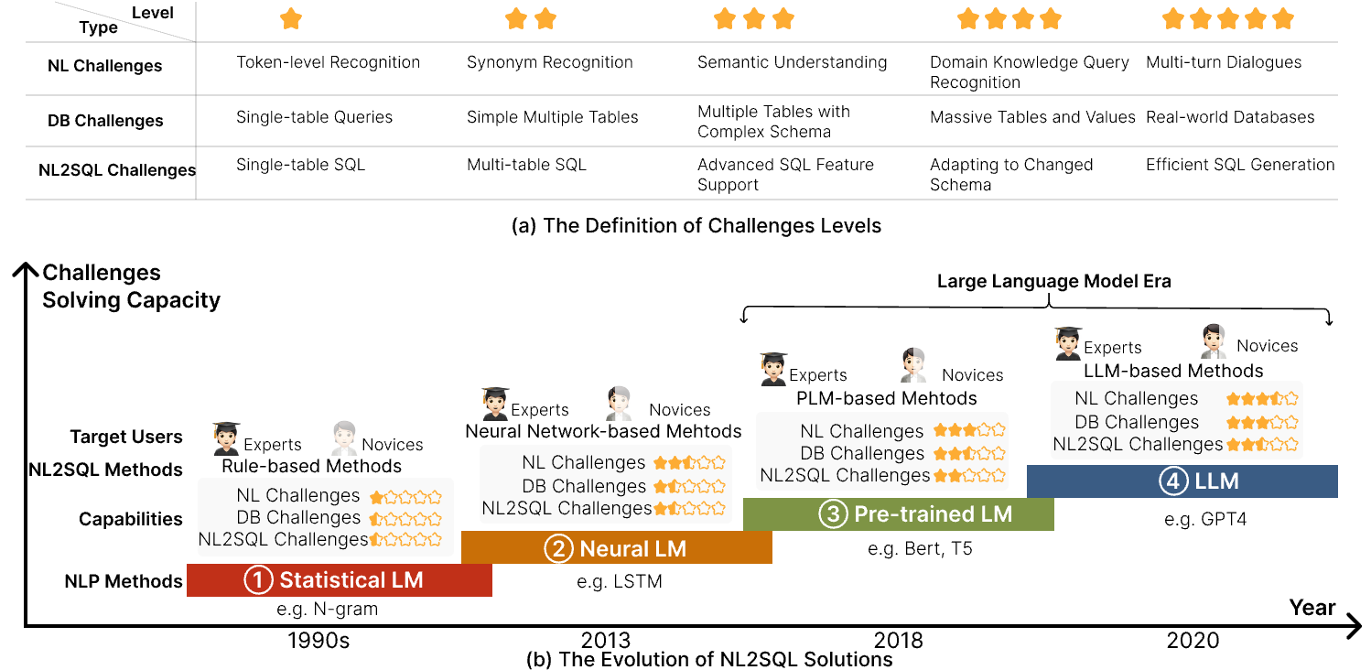
Where Are We?
Figure: The Evolution of NL2SQL Solutions from the Perspective of Language Models.
Notes:
We categorize the difficulty of Text-to-SQL into five levels, each addressing specific challenge. The development of Text-to-SQL solutions, illustrated in Figure (b), progresses through four distinct stages: the rule-based stage, the neural
network-based stage, the PLM-based stage, and the LLM-based stage. At each stage, we analyze target users and which Text-to-SQL challenges are addressed

Slide 10
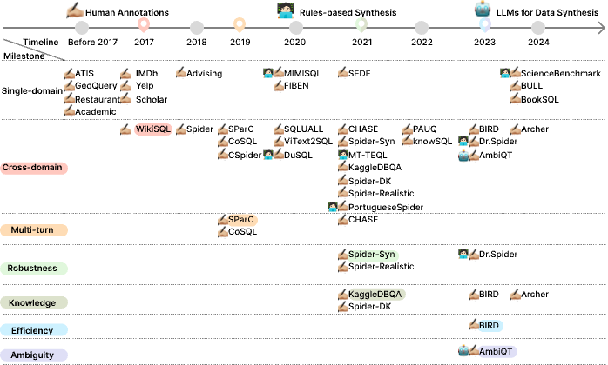
An Overview of NL2SQL Benchmarks
Notes:
从表中可以看出，呈现的趋势是从single domain 到multi-domain, 难度逐渐上升，出现了多轮对话数据集， 包含涉及knowledge，包含歧义性的数据集。 An interesting 现象是single domain的数据集重新站上历史的舞台。

Slide 11
NL2SQL Benchmark Discussion & Insights
From the Redundancy Measure perspective
We observe a trend from early datasets to recent ones where datasets have grown in size, including increases in the number of questions and unique queries.
From the Database Complexity perspective
The number of databases (and tables) in datasets correlates with the tasks (e.g., Single-domain vs. Robustness) they serve.
From the Query Complexity perspective
Recent datasets show a growing emphasis on Scalar Functions and Mathematical Computations in SQL queries, which introduces challenges in SQL generation structure not seen in earlier datasets.

Slide 12
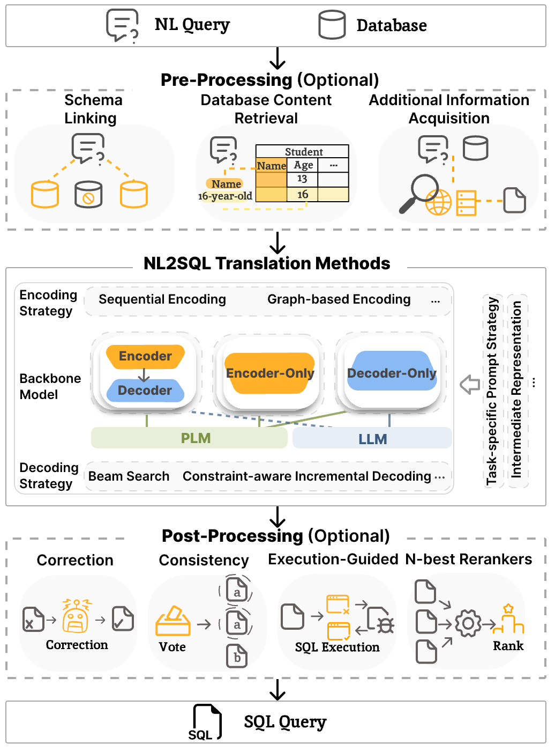
Tutorial Roadmap

Slide 13
Tutorial Roadmap
NL2SQL Solutions with PLMs and LLMs
Q1: How to design prompts and train PLMs/LLMs for NL2SQL?
Prompt Settings: Few-shot/Zero-shot
Training: SFT / RL
Q2: How effective are the core pre-processing techniques?

Slide 14
Tutorial Roadmap
NL2SQL Solutions with PLMs and LLMs
Q1: How to design prompts and train PLMs/LLMs for NL2SQL?
Q3: How can we build a robust NL2SQL Agent with LLMs?
Prompt Settings: Few-shot/Zero-shot
Training: SFT / RL
Q4: From NL2SQL Agents to Data Agents: Where are we going?
Q2: How effective are the core pre-processing techniques?
NL2SQL Solutions with (LLM) Agents

Slide 15
Tutorial Outline
Problem Definition, Preliminaries, Benchmarks
NL2SQL Solutions with PLMs and LLMs
NL2SQL Solutions with LLM Agents
Open Problems

Slide 16


NL2SQL Solutions with PLMs and LLMs
Rather than categorizing existing solutions by the specific PLMs or LLMs they employ, we classify them according to the practical considerations of different applications.
Consideration #1: The resources or costs required to develop NL2SQL
Computational resources (e.g., GPUs) for training
The monetary cost of calling LLMs (e.g., GPT) APIs
Model | Resources
RESDSQL + NatSQL | A100*1
CodeS | A800*8
Granite-20B-Code | A100*8+H100*8
Model | Input | Output
GPT-3.5-turbo | $0.50 / 1M tokens | $0.50 / 1M tokens
gpt-4o | $5 / 1M tokens | $15 / 1M tokens

Slide 17
NL2SQL Solutions with PLMs and LLMs
Rather than categorizing existing solutions by the specific PLMs or LLMs they employ, we classify them according to the practical considerations of different applications.
Consideration #2: The amount of data required for training NL2SQL
E.g., the CodeS model collects:
SQL-related data (11GB), NL-to-code data (6GB), and NL-related data (4.5GB)
E.g., the existing benchmarks paid much efforts to collect annotated data
Spider has 10,181 NL-SQL pairs
BIRD has 12,751 NL-SQL pairs
Notes:
虽然榜单指标很高，因为他们有足够的训练资源和数据作为基础。但是在真实场景下，模型的部署往往会在这两方面受到限制。

Slide 18
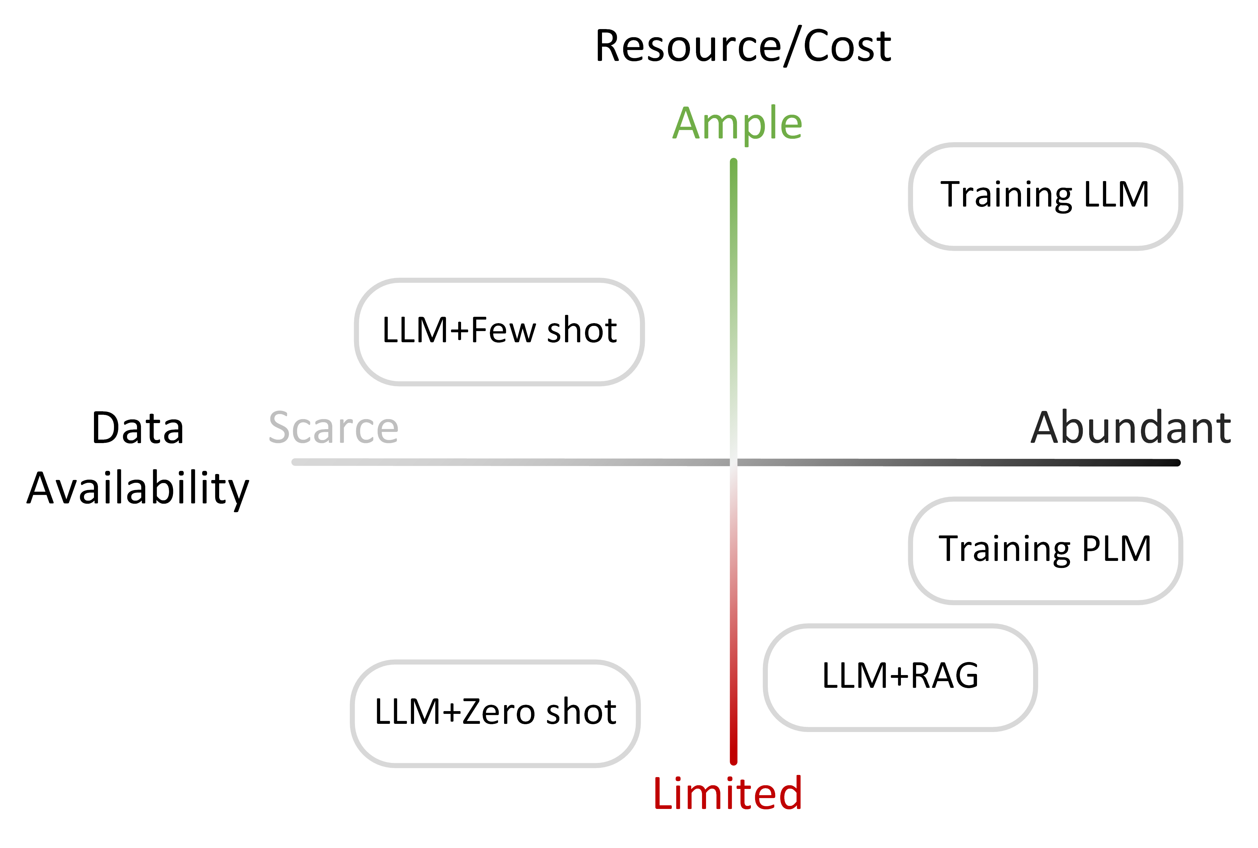
Categorization of Existing Studies
We categorize the existing studies of NL2SQL Solutions with PLMs and LLMs based on two dimensions: (1) Resources/Cost; (2) Data availability

Slide 19
Categorization of Existing Studies
PLM-based Methods
LLM+Zero-shot Methods
LLM+Few-shot Methods
Training LLM
Methods
Arctic-Text2SQL[12]
RESDSQL + NatSQL[8]
OpenSearch-SQL+GPT-4[7]
Omni-SQL[21]
C3 + ChatGPT + Zero-Shot[1]
MCS-SQL+GPT-4[6]
Graphix + PICARD[10]
ChatGPT + CoT[21]
Reasoning-SQL[14]
Reward-SQL[13]
N-best Rerankers + PICARD[22]
RASAT + PICARD[15]
MAC-SQL+GPT-4[20]
ZERoNL2SQL[5]
CHASE-SQL[19]
SC-Prompt[4]
DAIL-SQL+GPT-4[3]
CHESS[18]
T5 + PICARD[17]
Zero-shot GPT-4[13]
DIN-SQL+GPT-4[13]
DTS-SQL[14]
SFT CodeS[9]
Zero-shot CodeX[16]
RATSQL + GAP + NatSQL[2]
BRIDGE v2[11]
An Overview of NL2SQL Methods
18
Notes:
动画表示范老师组的工作

Slide 20
Few-Shot NL2SQL
Basic Idea
Utilizing the in-context learning capability of LLMs to generate SQL queries from a few demonstration examples.
Key Characteristics
Requirement of a handful of examples → Reduction of annotation costs
Technical Challenges
How to represent the structure of the underlying database
How to select and organize the demonstration examples

Slide 21
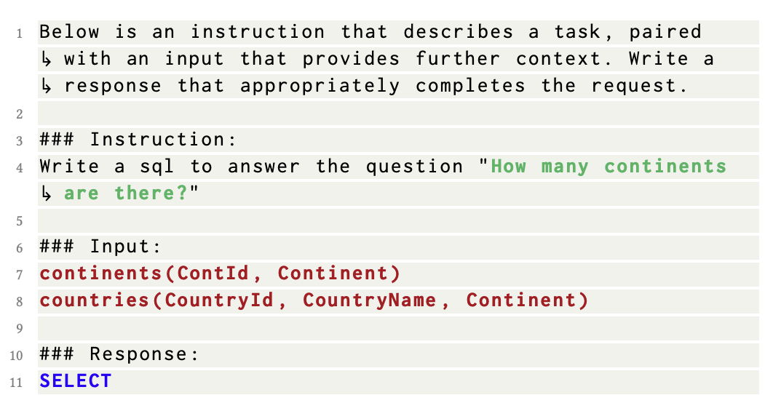
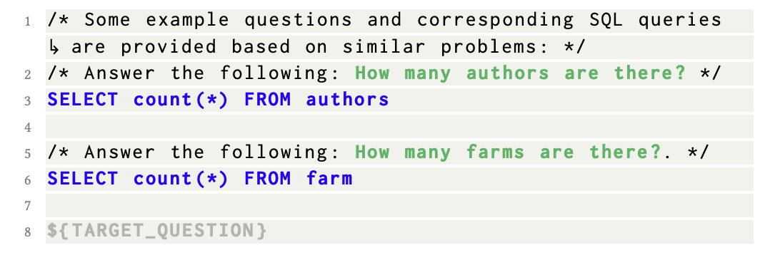
Few-Shot NL2SQL
DAIL-SQL, by Alibaba
Database Representation: representing database schema as CREATE TABLE statements with complete primary/foreign key information
Example Selection: combining question similarity and SQL query similarity, prioritizing examples with both similar questions and similar SQL structures
Example Organization: only preserving question-to-SQL mappings while removing token-expensive database schema from examples
Gao, Dawei, et al. "Text-to-sql empowered by large language models: A benchmark evaluation." PVLDB, 17(5): 1132-1145, 2024.

Slide 22
Zero-shot NL2SQL
Zero-shot NL2SQL
A practical scenario for NL2SQL is that oftentimes, for a new test environment, annotated NL-SQL pairs are time-consuming and labor-intensive to acquire, and thus is not available
Existing approaches may not perform well in this zero-shot NL2SQL setting, as the new test environments may be very different
New databases: an NL2SQL model trained on the Spider benchmark may not perform well for domain-specific (e.g., academic or financial) databases
New linguistic phenomena: varying linguistic phenomena (e.g., abbreviations, synonyms, etc.) in the test environments
Can we have a NL2SQL model generalizable to new test environments
Notes:
However, the existing approaches may not perform well in a “zero-shot” NL2SQL setting.
Specifically, a practical scenario for NL2SQL is that oftentimes, for new databases or applications, annotated NL-to-SQL pairs is time-consuming and labor-intensive to acquire, and thus is not available. In our work, we refer to the case of zero annotated NL-to-SQL pairs as zero-shot NL2SQL.
The reason that the existing approaches cannot work well is that the new test environments may be very different in the following aspects.
First is new databases: an NL2SQL model trained on the Spider benchmark may not perform well for domain-specific like academic databases
Second is new linguistic phenomena: varying linguistic phenomena like abbreviations in the test environments may lead to dramatic performance declines for existing NL2SQL models
Thus, we have a natural question: Can we have an NL2SQL model generalizable to new test environments?

Slide 23
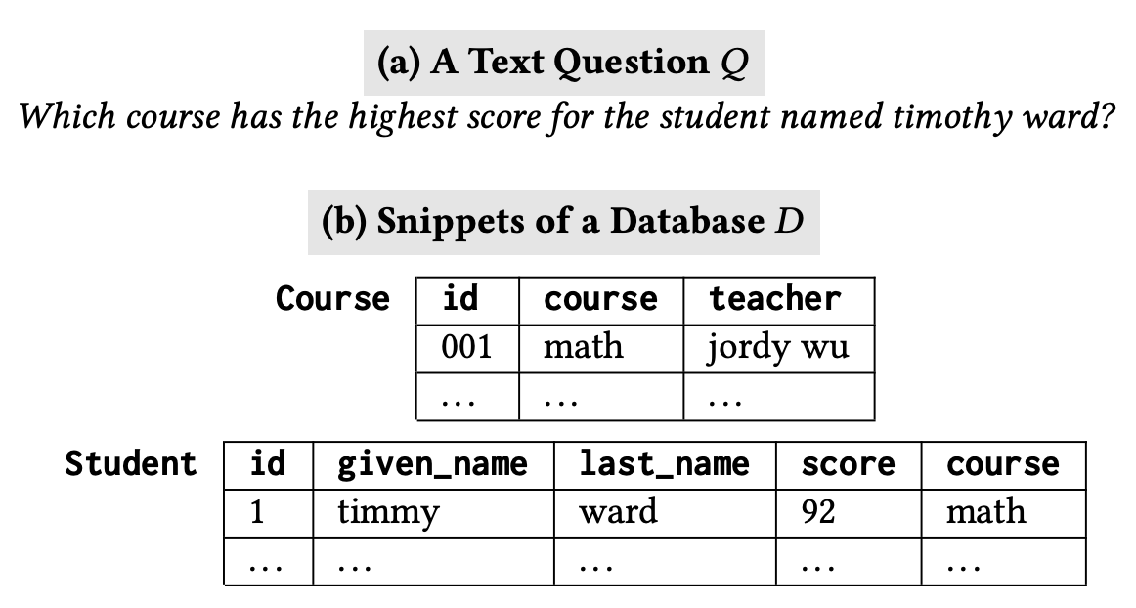
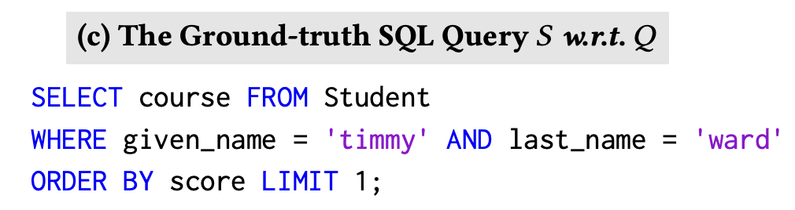
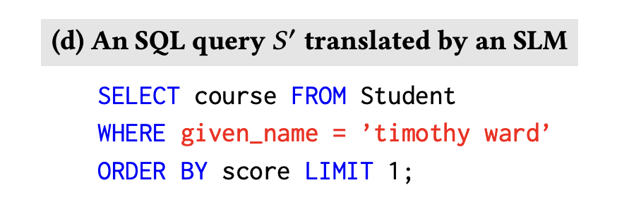
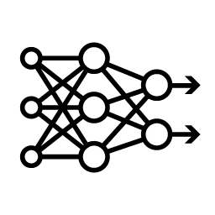
Limitation of Existing Solutions
The LM-based approaches to NL2SQL fall into two categories
Pre-trained language models (PLMs) such as BART and T5
Large language models (LLMs) such as GPT and PaLM
PLM-based methods (e.g., T5) may have limited generalizability in natural language reasoning in the zero-shot setting
Notes:
The SOTA solutions for NL2SQL mainly rely on pre-trained language models, which fall into two categories: small language models such as T5, and large language models such as GPT
SLM-based methods may have limited generalizability in natural language reasoning in our zeroshot settings, which may dramatically degrade the performance of the methods

Slide 24
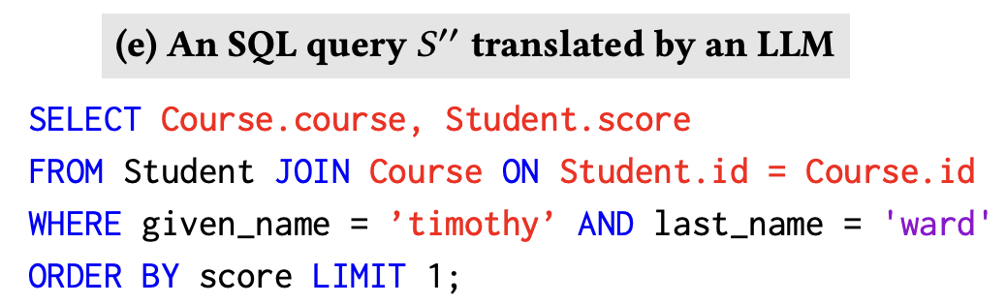

Limitation of Existing Solutions
The LM-based approaches to NL2SQL fall into two categories
Pre-trained language models (PLMs) such as BART and T5
Large language models (LLMs) such as GPT and PaLM
LLMs (e.g., gpt-3.5-turbo-0613) are capable of NL reasoning, but may not achieve precise alignment on schema and data value due to “hallucination”
Notes:
LLMs like GPT-3.5 have demonstrated remarkable reasoning abilities.
However, LLMs may not achieve precise schema alignment due to the “hallucination”: In particular, LLMs tend to choose more unrelated columns and tables like here (course) to cover the input content, leading to incorrect execution results.

Slide 25
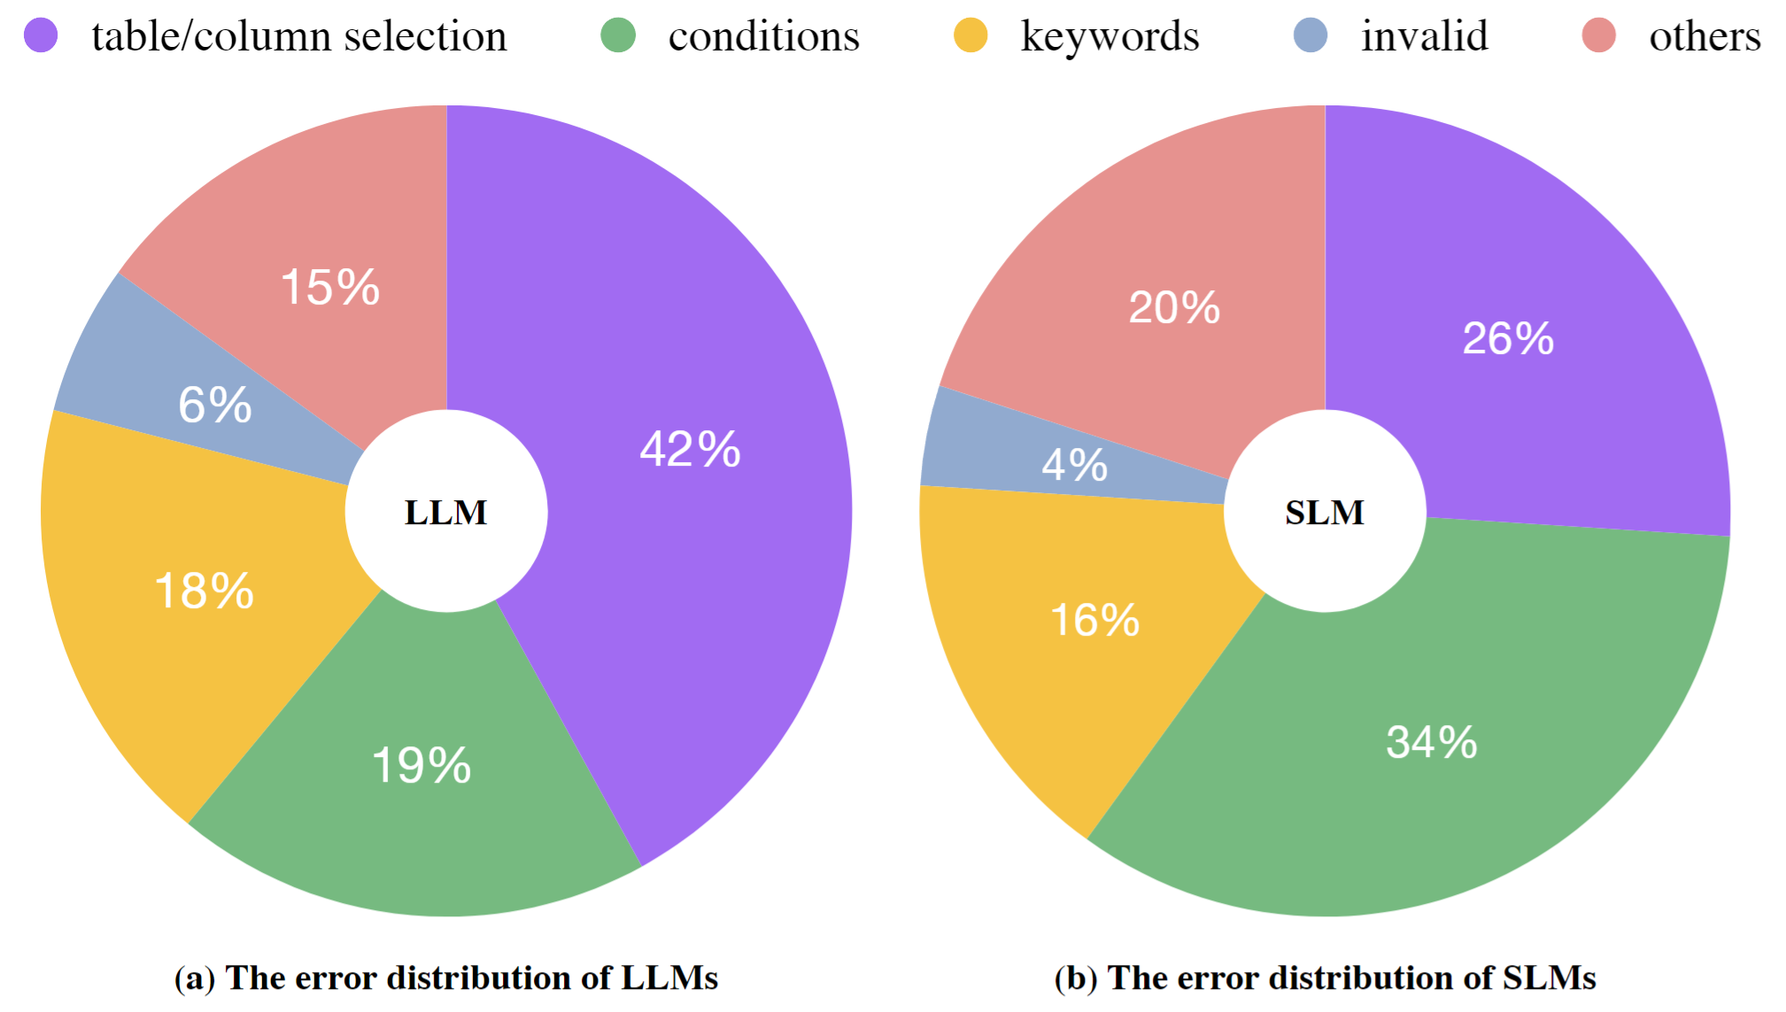



Limitations of Existing Solutions
A systematic error analysis that illustrates insights into limitations of the fine-tuned T5 and vanilla GPT-3.5
LLMs
PLMs
Complex NL Reasoning
Schema Alignment
Schema Alignment
Complex NL Reasoning
200 error examples sampled from Dr.Spider (GPT-3.5 and T5 respectively)
Can we combine PLMs and LLMs to solve Zero-shot NL2SQL?
Notes:
We have conducted an in-depth analysis to gain insights into strengths and limitations of the LLM and SLM solutions for zero-shot NL2SQL, and report the error distributions in the left figure.
From the figure we find that LLMs do well at complex NL reasoning like conditions but do poorly at scheme alignment like table/columns selection, but SLM is good at schema alignment but not good at complex NL reasoning.
Thus, we want to know if we can combine SLMs and LLMs to solve Zero-shot NL2SQL

Slide 26
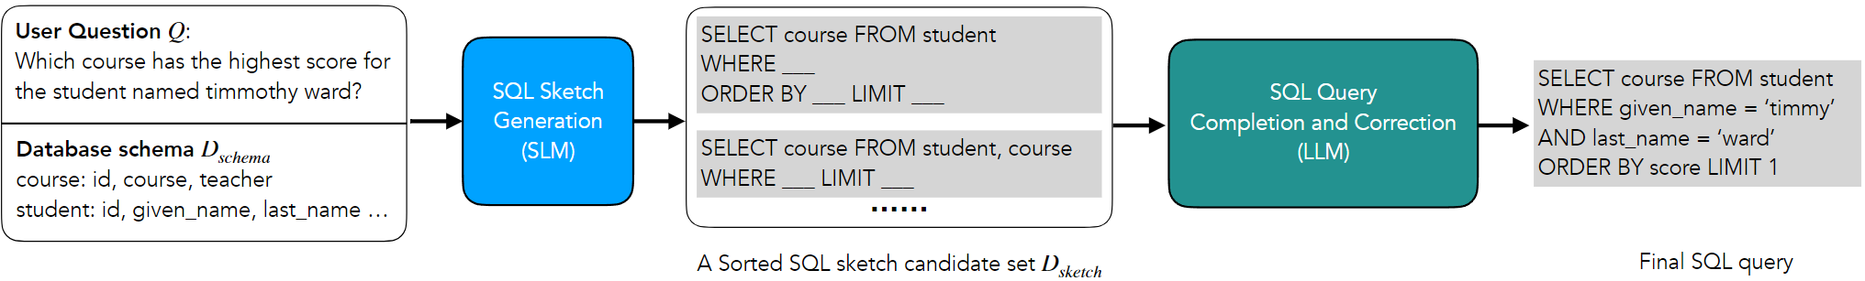
The ZeroNL2SQL Framework
ZeroNL2SQL breaks down the NL2SQL task into smaller sub-tasks
Sub-task 1: SQL Sketch Generation
Utilizing PLMs to generate a SQL sketch, with attributes to SELECT, tables in FROM, and necessary keywords (e.g., ORDER BY) for composing the SQL query
Sub-task 2: SQL Query Completion and Correction
Utilizing LLMs to complete the missing information in the SQL sketch and generate complete SQL queries, e.g., aligning with data values from the database
Zihui Gu, Ju Fan, Nan Tang, Songyue Zhang, Yuxin Zhang, Zui Chen, Lei Cao, Guoliang Li, Sam Madden, Xiaoyong Du: Combining Pre-Trained Language Models and Large Language Models for Zero-Shot NL2SQL Generation. VLDB 2024.
Notes:
Based on the insight, we propose ZeroNL2SQL, A framework that breaks down the NL2SQL task into two smaller sub-tasks.
The first sub task is SQL Sketch Generation, which aims to utilize SLMs to generate a SQL sketch, with attributes to SELECT, tables in FROM, and necessary keywords (e.g., ORDER BY) for composing the SQL query
The secong sub task is SQL Query Completion and Correction, which aims to utilize LLMs to complete the missing information in the SQL sketch and generate complete SQL queries, for example, aligning with data values from the database

Slide 27
Training LLMs for NL2SQL
Basic Idea
Training LLMs in two stages: (1) performing continual pre-training (CPT) on SQL-related corpora to strengthen SQL knowledge, and (2) conducting supervised fine-tuning (SFT) on curated NL2SQL datasets to specialize in SQL geneartion.
Key Characteristics
Enhanced SQL domain knowledge: CPT injects rich understanding of SQL syntax and semantics.
Superior reasoning capabilities: SFT enables models to gain stronger ability to parse complex natural language and map it to SQL queries.
Notes:
training plm: RESDSQL
zero: gpt-4(dail-sql), 额外的schema info（zeroNL2SQL）
few-shot: dail-sql
rag: db-info(paper???)
training LLM(research focus):
CPT+SFT: Codes
RL: DPO, Reasoning, RewardSQL
Synthesis: Omni-sql
每一part：介绍+paper+takeawy

Slide 28
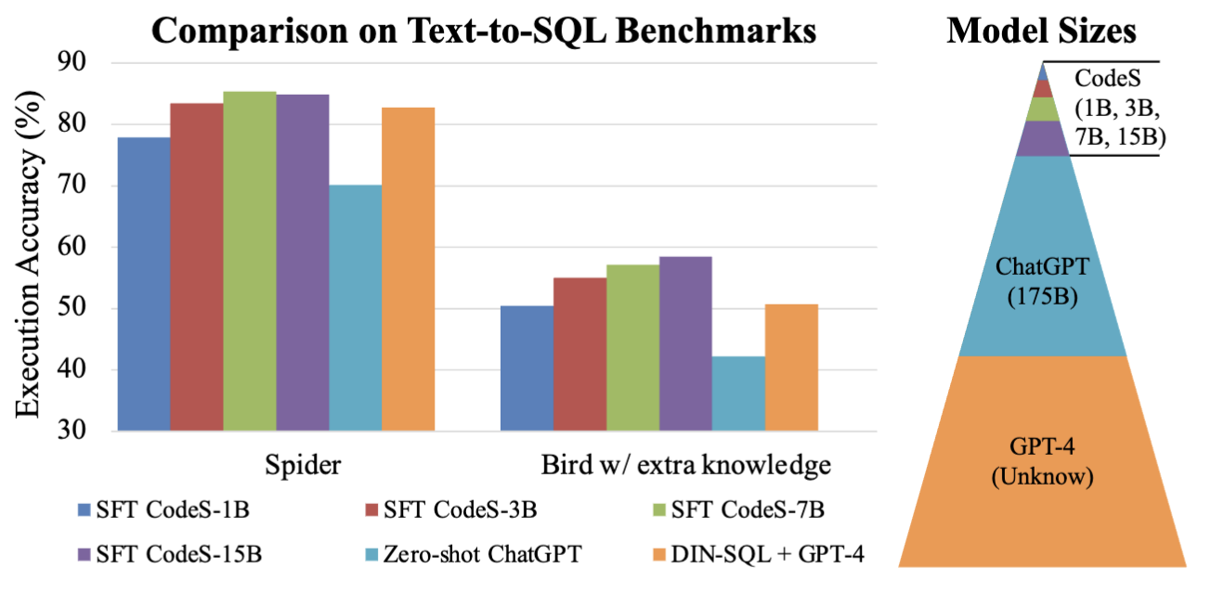
Training LLMs for NL2SQL
CodeS proposes to develop a new text-to-SQL model built on open-source models.
Solution Overview:
CodeS introduces a series of open-source language models (ranging from 1B to 15B parameters) specifically tailored for text-to-SQL tasks
Built on top of StarCoder, CodeS is further enhanced through CPT and SFT on a curated 21.5GB SQL-centric corpus.
Li, Haoyang, Jing Zhang, Hanbing Liu, Ju Fan, Xiaokang Zhang, Jun Zhu, Renjie Wei, Hongyan Pan, Cuiping Li, and Hong Chen. "Codes: Towards building open-source language models for text-to-sql." Proceedings of the ACM on Management of Data 2, no. 3 (2024): 1-28.

Slide 29
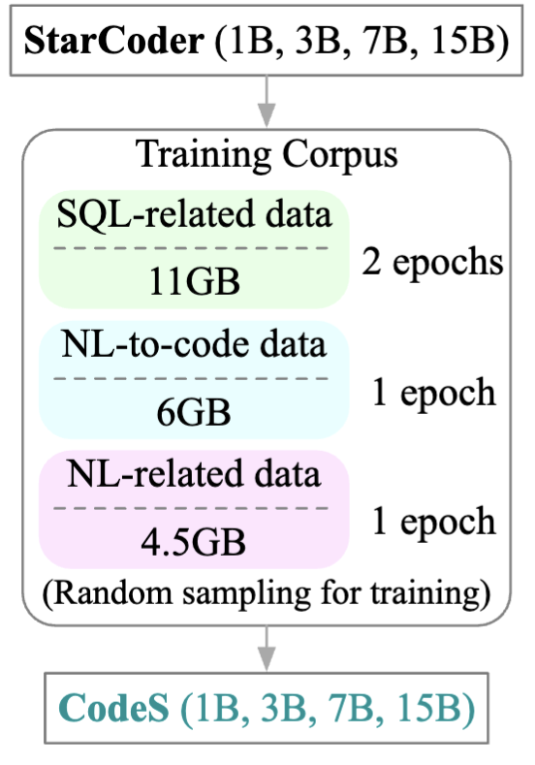
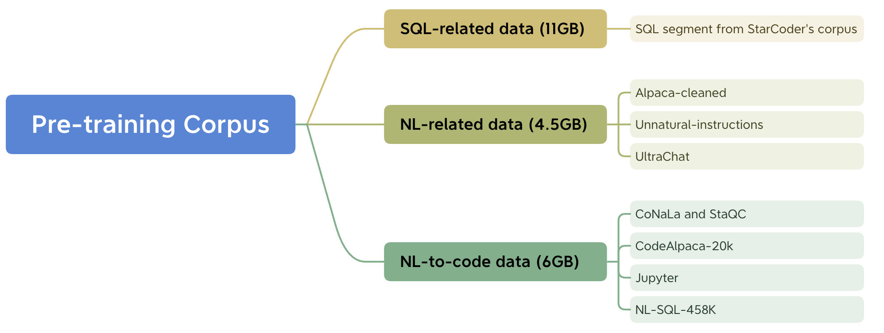
Data Collection for CPT and SFT
Curated CPT corpus: 11GB SQL-related data, 6GB NL-to-code data, and 4.5GB NL-related data
SFT corpus: NL-SQL-458K, containing 458K SQL queries paired with corresponding natural language questions
Enhanced capabilities: improvements in both SQL generation and natural language understanding
Step 1: Collect SQL-related corpus
Step 2: Incremental pre-training

Slide 30
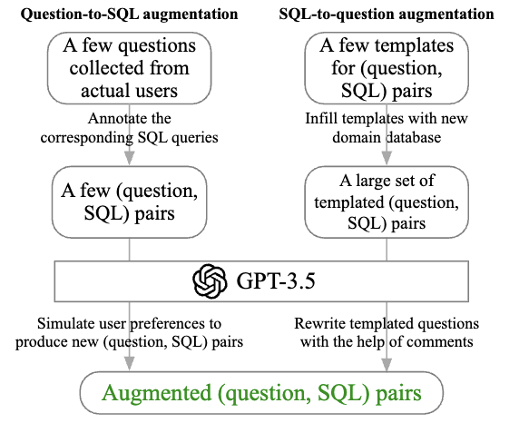
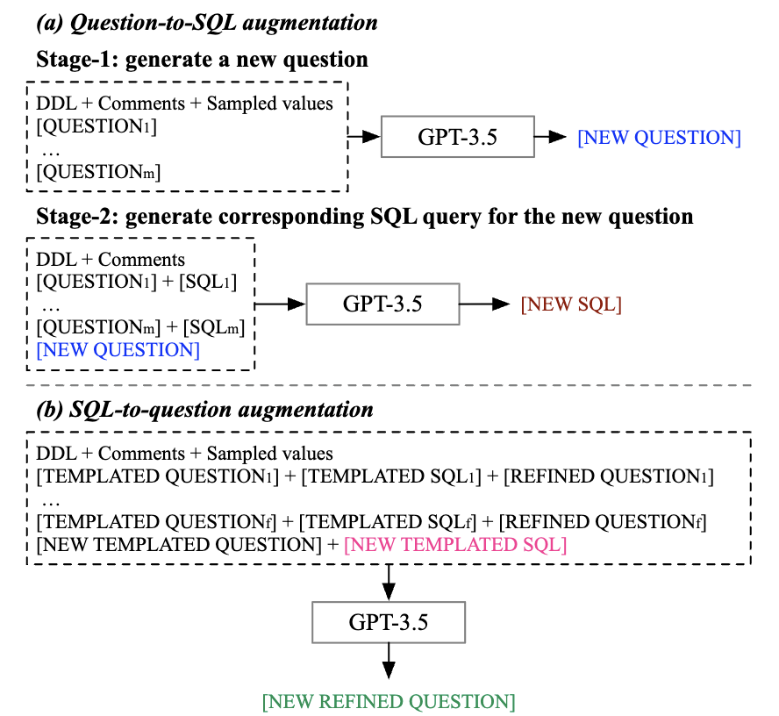
Data Augmentation for SFT
Question-to-SQL: starting from real user questions, manually annotate, and expanding using GPT-3.5
SQL-to-Question: leveraging Spider-style templates, populating with new domain schemas, and refining via GPT-3.5
Enhanced capabilities: rapid domain adaptation with minimal annotation effort
Bi-directional augmentation
Prompt formats used in data augmentation.

Slide 31
RL-based Training for NL2SQL
Reinforcement learning based training for NL2SQL leverages execution feedback and reasoning signals, and applies techniques such as DPO, GRPO, and reward-based optimization to generate SQL queries.
Key Characteristics:
Stronger Reasoning: RL fosters structured, step-by-step reasoning for better SQL generation
Richer Feedback: dedicated rewards overcome sparsity, guiding models more effectively
Higher Accuracy & Generalization: outperform larger models across benchmarks at lower cost

Slide 32
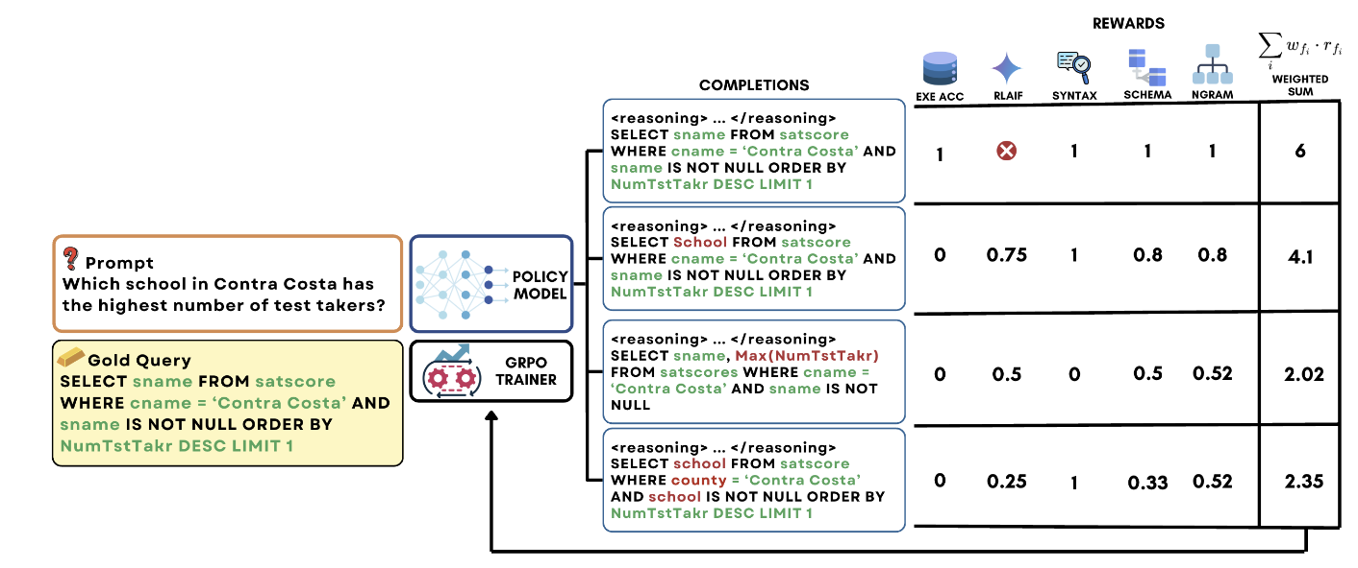
RL-based Training for NL2SQL
Reasoning-SQL, RL-Enhanced NL2SQ with Partial Rewards
Introducing the first RL-based framework for optimizing reasoning in LLMs for NL2SQL
Leveraging Group Relative Policy Optimization (GRPO) for efficient and stable training
Employing a novel suite of partial rewards to address the reward sparsity problem
Pourreza, Mohammadreza, Shayan Talaei, Ruoxi Sun, Xingchen Wan, et al. "Reasoning-sql: Reinforcement learning with sql tailored partial rewards for reasoning-enhanced text-to-sql." arXiv preprint arXiv:2503.23157 (2025).
Notes:
For each natural language prompt q and its associated database schema, there are the following key components in the RL-based training process
the policy model πθ generates a group of candidate SQL queries.
Each candidate is evaluated using a suite of reward functions to produce a composite reward.
These rewards are then used to compute advantages and update the policy via GRPO.
### 1️⃣ Policy Gradient (PG)
* **Goal:** Learn a parameterized policy $\pi_\theta(a|s)$ that maximizes expected return.
* **Basic idea:** Directly adjust policy parameters in the direction of higher reward:
$$
\nabla_\theta J(\theta) = \mathbb{E}_{\pi_\theta}\big[\nabla_\theta \log \pi_\theta(a|s) \, R \big]
$$
* **Problem:** High variance, unstable updates, sensitive to learning rate.
### 2️⃣ Proximal Policy Optimization (PPO)
* **Goal:** Stabilize policy gradient updates.
* **Basic idea:** Introduce a **clipped objective** to prevent large destructive updates:
$$
L^{CLIP}(\theta) =
\mathbb{E}_t \big[\min(r_t(\theta) A_t, \,
\text{clip}(r_t(\theta), 1-\epsilon,1+\epsilon) A_t )\big]
$$
* **Key point:** Needs a **critic (value function)** to estimate advantage $A_t$.
* **Impact:** Became a widely used standard for RLHF in LLMs.
### 3️⃣ Group Relative Policy Optimization (GRPO)
* **Goal:** Make RL training feasible and efficient for **large language models**.
* **Basic idea:**
* Generate a **group of candidate outputs** per input.
* Compare their **relative rewards** (e.g., execution accuracy, partial rewards).
* Update the policy to favor better candidates **without needing a critic**.
$$
L(\theta) = \mathbb{E}_x \Bigg[ \frac{1}{K}\sum_i
\frac{\exp(\beta (r_i - \bar{r}))}{\sum_j \exp(\beta (r_j - \bar{r}))}
\log \pi_\theta(y_i|x) \Bigg]
$$
* **Advantages:**
* Removes critic network → less memory & simpler training
* Uses **relative ranking** instead of absolute value → more stable updates
* **Policy Gradient:** Direct optimization of expected reward, but unstable.
* **PPO:** Adds stability with clipped updates and critic, enabling practical RL.
* **GRPO:** Adapts PPO ideas for LLMs by removing the critic and using relative ranking within candidate groups.

Slide 33
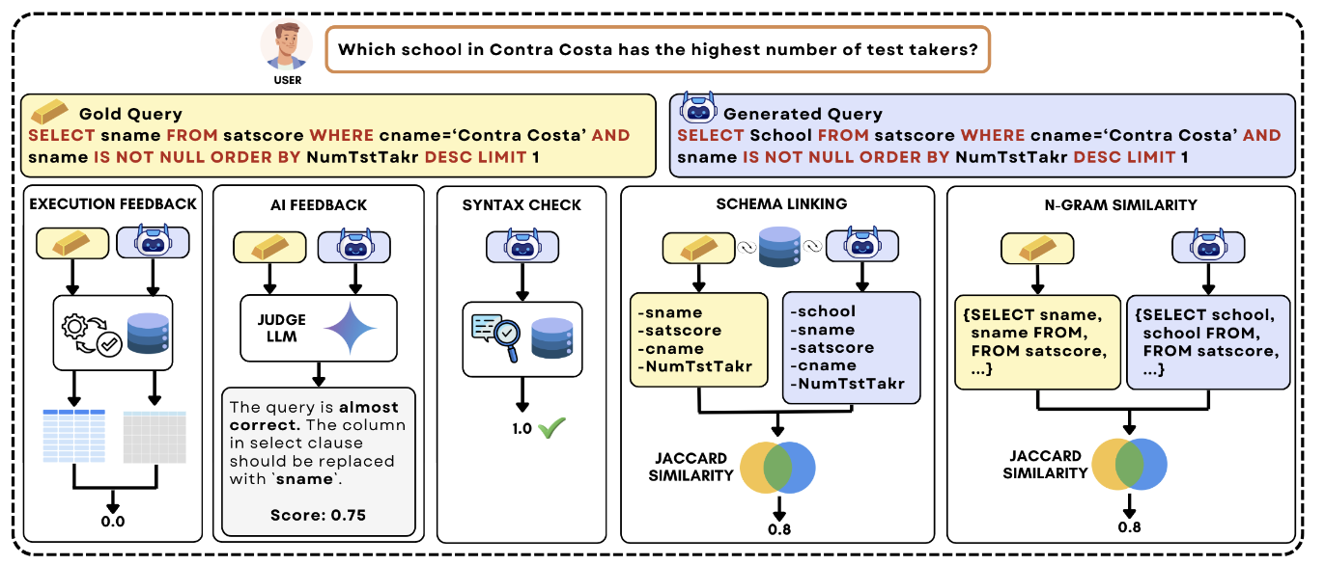
A Suite of Partial Rewards
Execution Accuracy Reward (RLEF): Binary reward for correct SQL execution
LLM-as-a-Judge Reward (RLAIF): AI feedback for queries with zero execution accuracy
Syntax Check Reward: Positive score for syntactically valid and executable queries
Schema Linking Reward: Jaccard similarity between schema items in candidate vs. gold queries
N-gram Similarity Reward: Token-level overlap measurement using Jaccard similarity

Slide 34
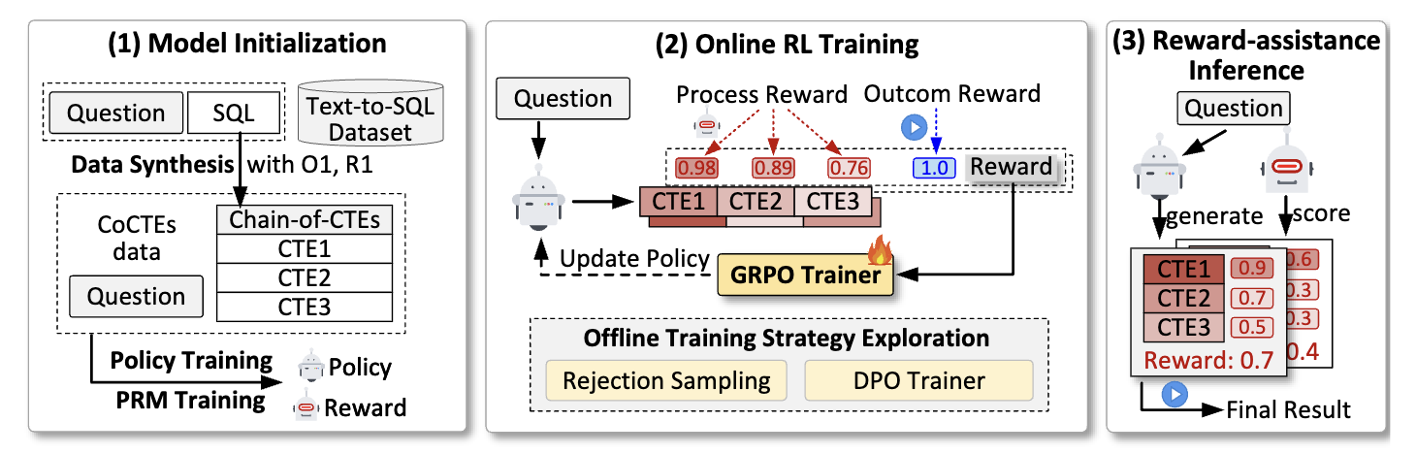
Process-Supervised Rewards for NL2SQL
Reward-SQL: introducing Process Reward Models (PRMs) for NL2SQL
PRM-Enhanced Test-Time Scaling: Adopting PRMs for test-time scaling for NL2SQL
GRPO-Integrated Training: Incorporating PRMs into training via Group Relative Policy Optimization to further enhance reasoning capabilities
Zhang, Yuxin, Meihao Fan, Ju Fan, Mingyang Yi, Yuyu Luo, Jian Tan, and Guoliang Li. "Reward-sql: Boosting text-to-sql via stepwise reasoning and process-supervised rewards." arXiv preprint arXiv:2505.04671 (2025).

Slide 35
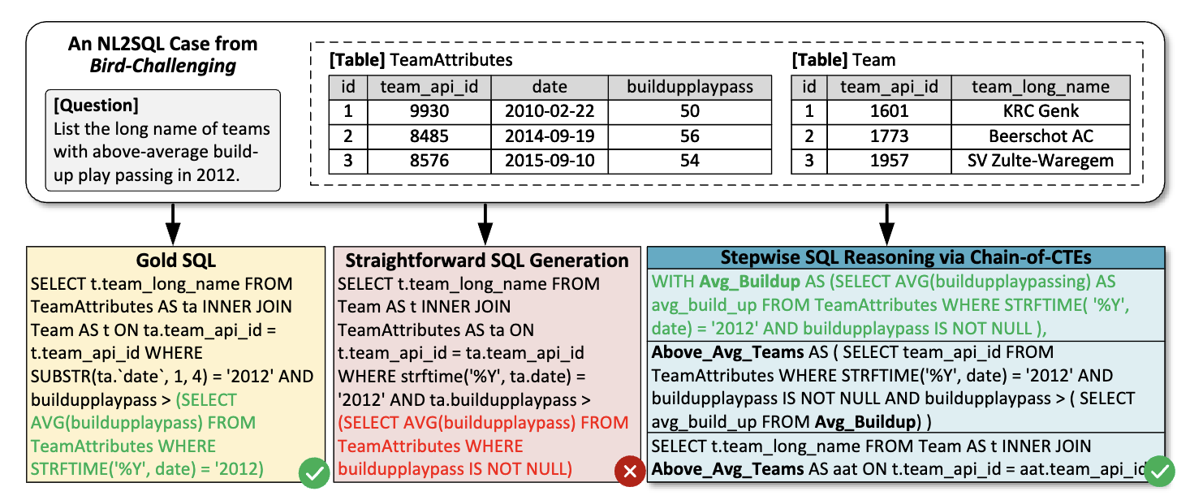
Process-Supervised Rewards for NL2SQL
SQL Query Decomposition: Breaks complex queries into step-by-step Common Table Expressions (CTEs)
Step-Level Executability: Each CTE produces concrete, verifiable intermediate results
PRM-Compatible Structure: Enables fine-grained evaluation at each reasoning step

Slide 36
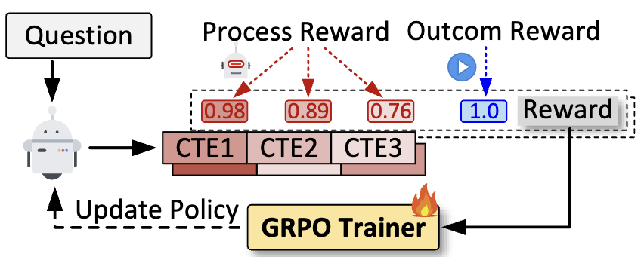
PRM-Involved GRPO Training
GRPO Model Update: Leveraging GRPO to update the model with PRM preferences, maintaining consistency between training and inference distributions to further enhance test-time scaling capabilities.
Combined Reward Structure: Process Reward (PR) + Outcome Reward (OR) for comprehensive feedback
Fine-Grained Advantages: Step-level advantages reflecting both solution quality and internal step variations
Online GRPO Training

Slide 37
Takeaways
Architectural Simplification: Text-to-SQL has evolved from complex multi-stage PLM pipelines to streamlined end-to-end training, with RL-based frameworks eliminating auxiliary components while achieving superior performance.
Escalating Data Demands: Simplified architectures paradoxically require exponentially more training data, making synthetic data generation critical while demanding unprecedented quality and diversity for robust generalization.
Performance-Cost Trade-off: State-of-the-art methods introduce substantial computational overhead, creating fundamental tensions between model performance and practical deployment in resource-constrained environments.
Notes:
training plm: RESDSQL
zero: gpt-4(dail-sql), 额外的schema info（zeroNL2SQL）
few-shot: dail-sql
rag: db-info(paper???)
training LLM(research focus):
CPT+SFT: Codes
RL: DPO, Reasoning, RewardSQL
Synthesis: Omni-sql
每一part：介绍+paper+takeawy

Slide 38
Tutorial Outline
Problem Definition, Preliminaries, Benchmarks
NL2SQL Solutions with PLMs and LLMs
NL2SQL Solutions with LLM Agents
Open Problems

Slide 39

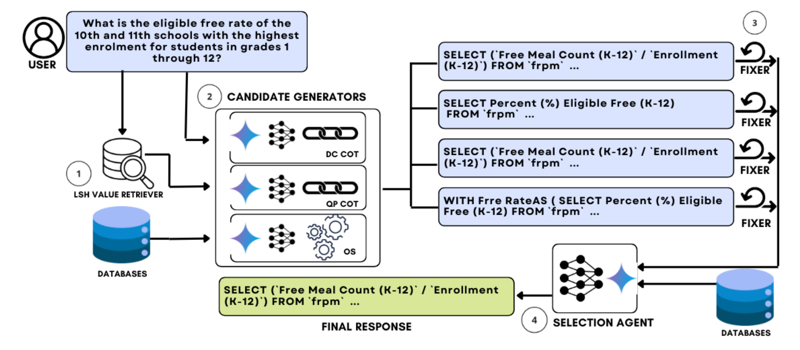
Where Are We?
CHASE-SQL (ICLR 2025, Google Cloud and Stanford)
Utilizes the MinHash LSH to search for values related to the user query
Multiple prompting strategies to generate various candidate SQL queries using LLMs, and corrects SQL queries with execution errors through prompting LLMs.
Employs an SQL selection agent fine-tuned specifically for the database to select the final SQL from multiple candidates.
Closed-source
LLMs
Notes:
Let’s look at two recent case studies. CHASE-SQL from Google and Stanford combines candidate generation with execution feedback and a fine-tuned SQL selection agent. It achieves strong performance

Slide 40
Where Are We?
CHASE-SQL (ICLR 2025, Google Cloud and Stanford)
Closed-source
LLMs
Key Limitations:
Reliance on closed-source large models
High cost (0.6 USD/query), making it difficult to widely deploy in real-world industrial scenarios.
SQL selection agent requires fine-tuning
The Google team fine-tuned the Gemini-1.5-Flash model specifically.
Limited flexibility due to reliance on domain-specific data.
Predefined and Fixed Reasoning Workflows
Notes:
but has limitations: heavy reliance on closed-source models, high cost per query, and fixed workflows.

Slide 41
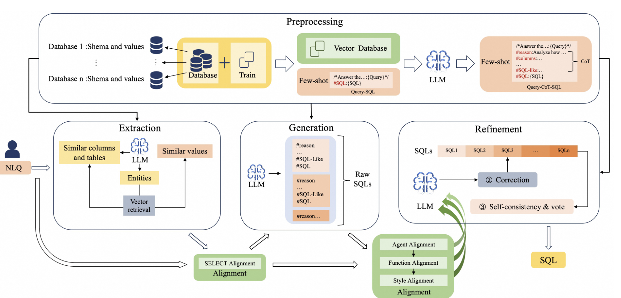
Where Are We?
OpenSearch (SIGMOD 25, Alibaba)
Modular Architecture: Divides the task into four stages (Preprocessing, Extraction, Generation, and Refinement) and adds an Alignment module to ensure consistency between steps.
Intermediate Language: A custom language named SQL-Like is designed to structure the model's reasoning process.
Closed-source
LLMs
Notes:
OpenSearch, from Alibaba, adopts a modular pipeline: preprocessing, extraction, generation, refinement, and an alignment module. It introduces a custom SQL-like intermediate language to structure reasoning. While effective, it suffers from rigidity — once the alignment style is fixed, adaptability drops. Both examples highlight a tension: pipelines give structure and reliability, but often sacrifice flexibility, adaptability, and cost efficiency.

Slide 42
Where Are We?
OpenSearch (SIGMOD 25, Alibaba)
Closed-source
LLMs
Key Limitations:
Reliance on closed-source large models
Privacy Risks
Rigidity of the Alignment Module:
The alignment mechanism enforces consistency but risks over-constraining SQL generation and limiting adaptability across scenarios.
Predefined and fixed reasoning workflows

Slide 43

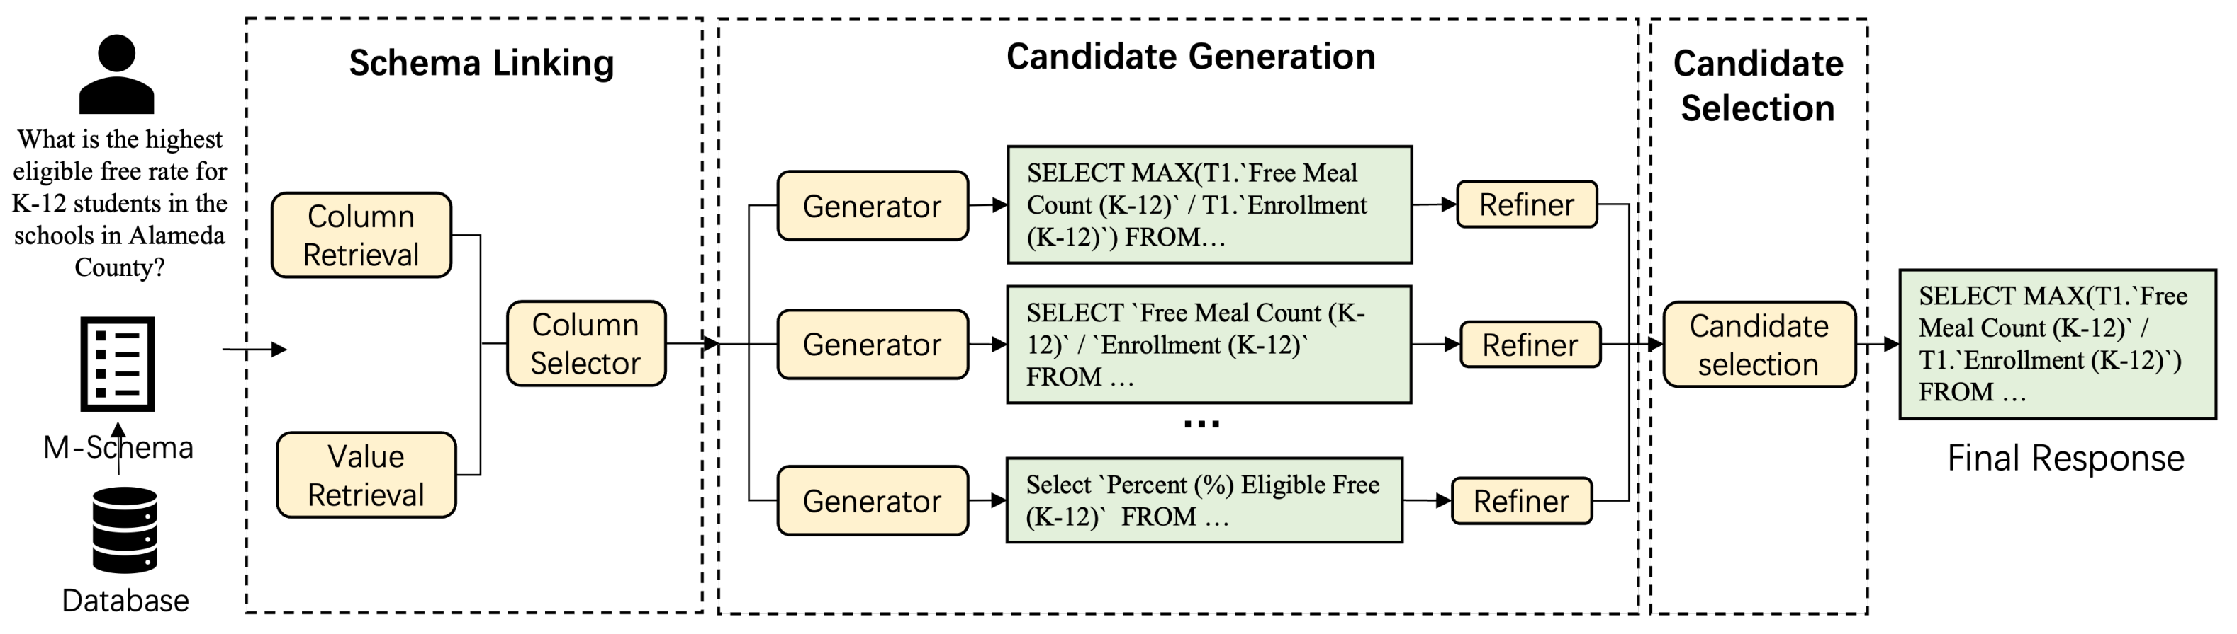
Where Are We?
XiYan-SQL (SIGMOD 25, Alibaba)
M-Schema: Uses column and value retrieval to select relevant schema items from DBs.
Fine-tunes a base LLM on SQL-specific data, then creates multiple specialized SQL-generation models by fine-tuning with diverse Text-to-SQL syntax datasets.
Employs a fine-tuned SQL selection model to choose the best SQL from predictions made by multiple generators.
Open-source LLMs

Slide 44
Where Are We?
XiYan-SQL (SIGMOD 25, Alibaba)
Open-source LLMs
Key Limitations:
High dependency on extensive domain-specific data.
Significant costs associated with fine-tuning multiple models.
Difficulty in rapid adaptation and generalization across varied scenarios.
Predefined and Fixed Reasoning Workflows.

Slide 45
Key Takeaways
Closed-source LLMs for Text-to-SQL:
High inference API cost limits practical deployments.
Potential data privacy concerns for sensitive applications.
Open-source LLMs for Text-to-SQL:
Dependence on extensive domain-specific data for model fine-tuning.
Limited generalization capability across different use cases.
Common Limitations in Existing Solutions:
Predefined and fixed reasoning workflows restrict adaptability.
Domain adaptation and generalization across DB and text queries
Notes:
So what have we learned?
Closed-source LLMs deliver excellent accuracy but suffer from high API costs, privacy concerns, and limited transparency. Open-source LLMs, in contrast, offer flexibility and lower cost, but require heavy fine-tuning and domain-specific data, and often generalize poorly. Both, crucially, rely on predefined, fixed workflows that limit adaptability.
This motivates us to rethink: Can we design agents that reason dynamically, rather than follow rigid scripts?

Slide 46
Where Are We Going?
Challenges
Key Idea
🔒
High Inference API Cost
Open-source LLMs
⚙️
Lower deployment cost and improved flexibility
Our Goal
Reasoning Agents
based on
Open-source LLMs
🔧
Expensive fine-tuning
Training-free Paradigm
🚀
Zero-shot reasoning without additional tuning
📌
Fixed Reasoning
Dynamic Reasoning
🔄
Adaptive reasoning workflows guided by task
Notes:
This brings us to the key forward-looking direction. Instead of closed pipelines and static models, we envision reasoning agents:
Based on open-source LLMs for flexibility,
Adopting a training-free paradigm whenever possible,
And employing dynamic reasoning workflows that adapt to task requirements. This perspective reduces cost, improves adaptability, and opens new opportunities for research.

Slide 47
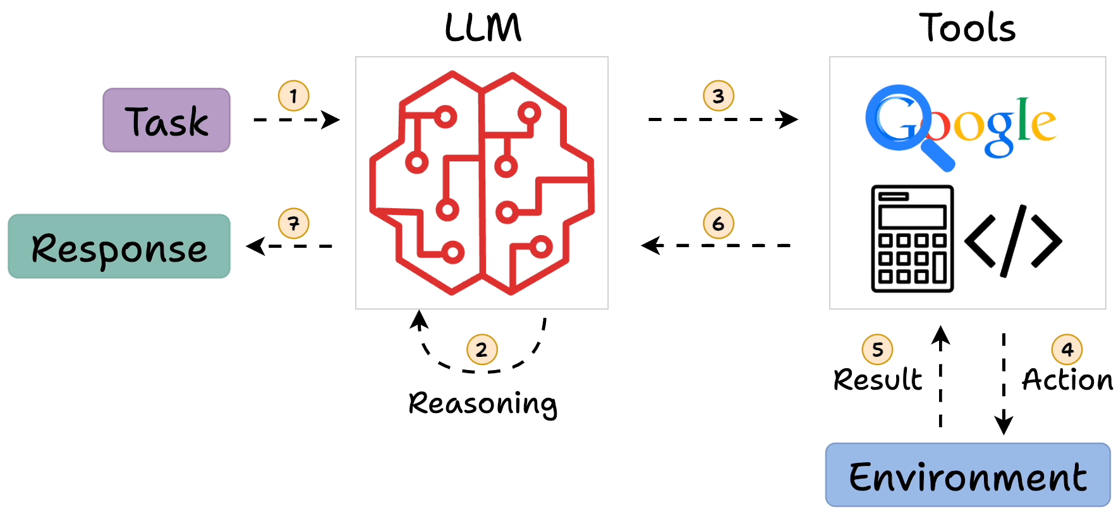
What is the (Reasoning) Agent?
https://blog.dailydoseofds.com/p/intro-to-react-reasoning-and-action
Notes:
A reasoning agent is more than just an LLM. It follows the ReAct paradigm: reasoning and action in a loop. That means: interpreting the query, planning next steps, calling tools or databases, reflecting on results, and iterating until a reliable SQL is produced. This shift — from static model inference to agentic reasoning — is what enables robustness and transparency

Slide 48
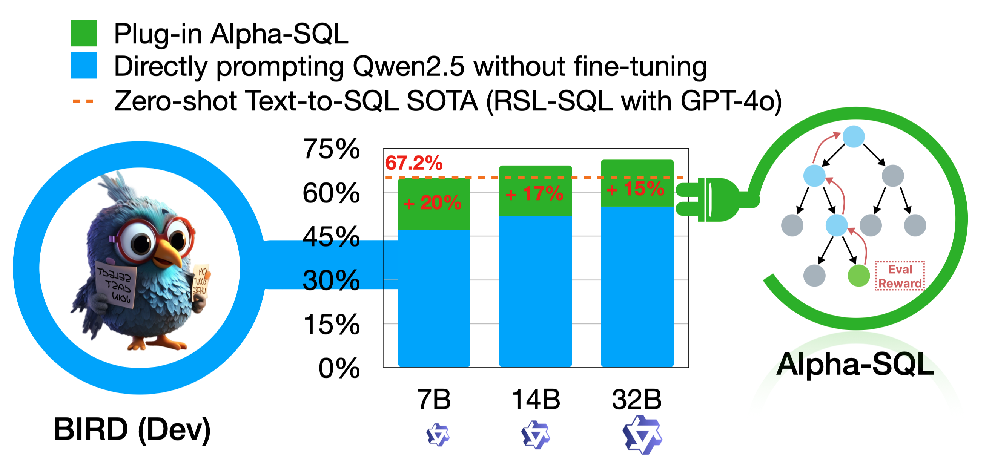
Alpha-SQL: A Plug-and-Play NL2SQL Reasoning Framework
Open-source LLMs
Training-free Paradigm
Dynamic Reasoning
Boyan Li, Yuyu Luo, Alpha-SQL: Zero-Shot Text-to-SQL using Monte Carlo Tree Search, ICML 2025.
https://github.com/HKUSTDial/Alpha-SQL
Notes:
Alpha-SQL is our proposed solution. We call it “plug-and-play” because it is designed to work with existing tools and models without additional training, and you can plug in different components as needed. The framework embodies three key characteristics:

Slide 49
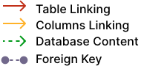
NL2SQL Human Workflow
Step-1 NL Understanding
Find the number of dog pets that are raised by female student
Find the number of dog pets that are raised by female student
Step-2 Schema Linking and Database Content Retrieval
Pets
PetID | PetType | PetAge | ...
 | Dog
Student
StuID | Sex | Age | ...
 | F
Has_Pet
PetID | StuID | ...
Step-3 Translating the NL Intent into the SQL​
Select count(*) FROM student AS T1 JOIN has_pet AS T2 ON T1.stuid=T2.stuid JOIN pets AS T3 ON T2.petid=T3.petid WHERE T1.sex=‘F’ AND T3.pettype=‘Dog’
Notes:
How can a user query a database using natural language? Imagine a user asks, “Who are the three youngest winners across all matches, and what are their ranks?” A NL2SQL system takes this natural language (NL) query from the user and translates it into the corresponding SQL query that the database can execute. The database then executes this SQL and returns the results to the user. The interface thereby bridges humans and databases: the human expresses their information need in everyday language, and the system generates the precise database query to retrieve the answer. This is incredibly valuable for democratizing access to data – allowing people who aren’t SQL experts to still leverage the full power of databases.
However, building an accurate NL2SQL system is far from trivial.

Slide 50
Task Formulation: Mimic Human Experts
Human Expert Workflow for Text-to-SQL
No
Q
Test
Understand Intent
Link to Schema
Design SQL Logic
Compose SQL
Yes
SQL
DB

Slide 51
Task Formulation: Mimic Human Experts
Human Expert Workflow for Text-to-SQL
No
Q
Test
Understand Intent
Link to Schema
Design SQL Logic
Compose SQL
Yes
SQL
DB
From Human Actions to Agent Actions
👷🏻‍♂️
🤖
Understand Intent
Question Rephrasing
(Revise, clarify ambiguities, rephrasing)
Link to Schema
Schema Selection
(decides which tables / columns / values)
Cell Value Selection
Design SQL Logic
Column Function
(joins, aggregations, functions)
Compose SQL
SQL Generation
(assemble an initial executable query)
Validate & Iter.
SQL Revision
(iteratively test, debug, and optimize the query)

Slide 52
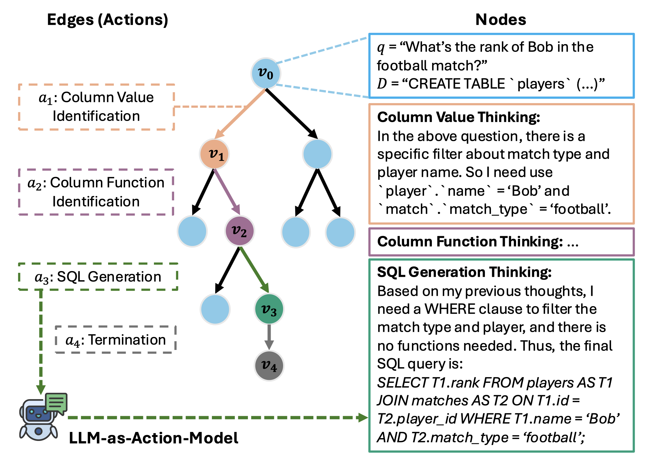
Task Formulation: Mimic Human Experts
Human Expert Workflow for Text-to-SQL
No
Q
Test
Understand Intent
Link to Schema
Design SQL Logic
Compose SQL
Yes
SQL
DB
From the Fixed Action to Dynamic Actions
Tree-based Search:
Each edge corresponds to an agentic action in the query construction process,
Each node represents a reasoning state at a specific step, and
Each path corresponds to a sequence of SQL construction actions for Text-to-SQL task.

Slide 53





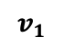
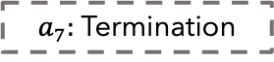
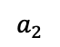
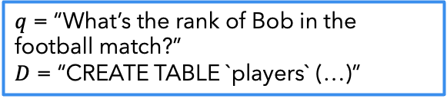
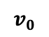
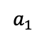
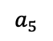
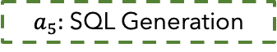











Text-to-SQL as a Tree-based Search Problem
Action Space
$$a_{1}$$
Rephrase Question
Edges (Actions)
Nodes (Reasoning States)
$$a_{2}$$
Schema Selection
$q$ = “What’s the rank of Bob in the football match?”
$D$ = “CREATE TABLE `players` (…)”
$$a_{3}$$
Column Value Identification
$$v_{0}$$
Question
Database
$a_{3}:$ Column Value
Identification
Input
$$a_{4}$$
Column Function Identification
Column Value Thinking:
In the above question, there is a specific filter about match type and player name. So I need use `player`.`name` = ‘Bob’ and `match`.`match_type` = ‘football’.
$$a_{5}$$
SQL Generation
$$v_{1}$$
$$a_{6}$$
SQL Revision
$a_{4}:$ Column Function
Identification
$$a_{7}$$
Termination
$$v_{2}$$
Column Function Thinking: …
LLM-as-Action-Model
$a_{5}:$SQL Generation
SQL Generation Thinking:
Based on my previous thoughts, I need a WHERE clause to filter the match type and player, and there is no functions needed. Thus, the final SQL query is:
SELECT T1.rank FROM players AS T1 JOIN matches AS T2 ON T1.id = T2.player_id WHERE T1.name = ‘Bob’ AND T2.match_type = ‘football’;
$$v_{3}$$
Question
Database
Previous
Actions
$a_{7}:$Termination
$$v_{4}$$
$$a_{i}$$
Output
$$v_{i+1}$$
Action
LLM
Next State
LLM-as-Action-Model

Slide 54
Text-to-SQL as a Tree-based Search Problem
Q1: How to select the next action (edge)?
Q2: How to effectively navigate the vast search space?
Q3: How to evaluate the quality of the candidate SQL queries?
Q1 & Q2
Monte Carlo Tree Search (MCTS) addresses this by balancing exploration (testing uncertain actions) and exploitation (choosing actions likely to yield good results)
Q3
We need a self-supervised reward function since our goal is to avoid reliance on labeled data
Resampling the LLMs M times to compute the self-consistent scores

Slide 55

Alpha-SQL Solution Overview
Boyan Li, Yuyu Luo, Alpha-SQL: Zero-Shot Text-to-SQL using Monte Carlo Tree Search, ICML 2025.
https://github.com/HKUSTDial/Alpha-SQL

Slide 56


Alpha-SQL: Plug-and-Play Capabilities
Notes:
Alpha-SQL demonstrates the promise of this reasoning-as-search paradigm. It can plug into different LLMs, acting as a wrapper that improves their reliability without retraining. The MCTS engine orchestrates candidate generation, pruning, and verification. Experiments show that Alpha-SQL achieves strong zero-shot performance, rivaling fine-tuned models, while remaining training-free. It illustrates the power of agentic reasoning layered over existing LLMs.

Slide 57

Performance-Scale Trade-off Analysis
Agents: Small LLMs, Big Gains

Slide 58
Tutorial Outline
Problem Definition, Preliminaries, Benchmarks
NL2SQL Solutions with PLMs and LLMs
NL2SQL Solutions with LLM Agents
Open Problems

Slide 59
Rethinking: Limitations of NL2SQL Agent
Boyan Li, Yuyu Luo, Alpha-SQL: Zero-Shot Text-to-SQL using Monte Carlo Tree Search, ICML 2025.
https://github.com/HKUSTDial/Alpha-SQL
Notes:
Despite the progress of agent-based frameworks like Alpha-SQL, there remain fundamental limitations.

Slide 60
Rethinking: Limitations of NL2SQL Agent
L1: Efficiency is a significant limitation of MCTS with edge scaling:
On average, it takes around 5 minutes to complete a single Text-to-SQL task.
This severely restricts its applicability in real-world scenarios.
Boyan Li, Yuyu Luo, Alpha-SQL: Zero-Shot Text-to-SQL using Monte Carlo Tree Search, ICML 2025.
https://github.com/HKUSTDial/Alpha-SQL
Notes:
First, efficiency bottlenecks. Monte Carlo Tree Search, while effective, is extremely slow. On average, one query can take up to five minutes. This makes it impractical for real-world deployments.

Slide 61
Rethinking: Limitations of NL2SQL Agent
L2: Single LLM is prone to errors and lacks diverse perspectives, reducing reasoning stability
L1: Efficiency is a significant limitation of MCTS with edge scaling
On average, it takes around 5 minutes to complete a single Text-to-SQL task.
This severely restricts its applicability in real-world scenarios.
Boyan Li, Yuyu Luo, Alpha-SQL: Zero-Shot Text-to-SQL using Monte Carlo Tree Search, ICML 2025.
https://github.com/HKUSTDial/Alpha-SQL
Notes:
Second, reasoning instability. A single LLM is prone to hallucinations and logical errors. Without diverse perspectives or self-consistency, reasoning often collapses prematurely.

Slide 62
Rethinking: Limitations of NL2SQL Agent
L1: Single LLM is prone to errors and lacks diverse perspectives, reducing reasoning stability
L3: Limited actions (Tools), constrained to only predefined, LLM-based actions
L2: Efficiency is a significant limitation of MCTS with edge scaling
On average, it takes around 5 minutes to complete a single Text-to-SQL task.
This severely restricts its applicability in real-world scenarios.
Boyan Li, Yuyu Luo, Alpha-SQL: Zero-Shot Text-to-SQL using Monte Carlo Tree Search, ICML 2025.
https://github.com/HKUSTDial/Alpha-SQL
Notes:
Third, limited action space. Current agents mostly rely on SQL-only actions. They cannot flexibly invoke external tools, value retrievers, SQL validators, or even humans-in-the-loop.
These limitations highlight what is needed next: more diverse actions, efficient reasoning strategies, and richer memory integration.

Slide 63
Rethinking: Limitations of NL2SQL Agent
These limitations highlight the need for more diverse actions, efficient reasoning, and richer memory
L2: Single LLM is prone to errors and lacks diverse perspectives, reducing reasoning stability
L3: Limited actions (Tools), constrained to only predefined, LLM-based actions
L1: Efficiency is a significant limitation of MCTS with edge scaling
On average, it takes around 5 minutes to complete a single Text-to-SQL task.
This severely restricts its applicability in real-world scenarios.
Boyan Li, Yuyu Luo, Alpha-SQL: Zero-Shot Text-to-SQL using Monte Carlo Tree Search, ICML 2025.
https://github.com/HKUSTDial/Alpha-SQL
Notes:
These limitations motivate us to rethink the NL2SQL agent architecture and explore new opportunities.

Slide 64
What Alpha‑SQL Reveals About NL2SQL Agents
(Alpha‑SQL) Limitation | Opportunity Axis | Design Lever (what to change)
L1. Efficiency bottleneck (MCTS is slow) | Planning | Adaptive search budgets, routing by query difficulty, test‑time compute allocation
 | Tools | Early pruning via validators / partial execution; cost-aware candidates
 | Memory | Cache schema/context/results; reuse prior plans
L2. Reasoning instability / low diversity | Actions | Multi‑agent/committee, self‑consistency, human-as-an-agent for disambiguation
 | Perception | Better query & schema understanding (scope detection, value grounding)
L3. Limited actions & tool use | Tools | Add retrievers, value lookups, execution‑guided rewrite, SQL checkers
 | Memory | Long context + vector memory for task state & user prefs; Metadata Management and Schema Interpretation
Notes:
This figure generalizes the NL2SQL agent architecture:
Perception involves understanding queries, schemas, and the surrounding environment.
Planning covers pre-processing, SQL generation, and post-processing.
Actions range from calling LLMs, to tools, to human experts.
Memory stores schemas, metadata, and knowledge for long-term reuse.
From this design, we can identify five key research opportunities:
Richer perception for better schema and value understanding.
Adaptive planning with budget-aware resource allocation.
Broader action space, beyond SQL-only interaction.
Human-as-an-agent, for disambiguation and policy-sensitive queries.
Stronger memory, combining short-term context with semantic catalogs.
This provides a blueprint for the next generation of NL2SQL agents

Slide 65
Opportunities for NL2SQL Agents: Five Key Aspects
NL2SQL Agent
Perception
Query Understanding
Schema Understanding
Environment Understanding
Planning
Pre-Processing
SQL Generation
Post-Processing
Actions
Call LLMs
Call Tools
Tools
SQL Verifier
Query Executor
Memory
Vector Database
Metadata
Knowledge
Call Humans
Optimization Goal
…
…
…
…

Slide 66
Opportunities for NL2SQL Agents: Five Key Aspects
NL2SQL Agent
Perception
Query Understanding
Schema Understanding
Environment Understanding
Planning
Pre-Processing
SQL Generation
Post-Processing
Actions
Call LLMs
Call Tools
Tools
SQL Verifier
Query Executor
Memory
Vector Database
Metadata
Knowledge
Call Humans
Optimization Goal
…
…
…
…

Slide 67

Notes:
Why Verification Is Necessary

Slide 68


😔 Execution ACC ～75%
😔Execution ACC ～30%
https://bird-bench.github.io/
https://spider2-sql.github.io/
Notes:
In fact, NL2SQL systems are unreliable.
Give an example, consider the most popular benchmarks. Even top-performing methods achieve only about seventy-five percent execution accuracy on the BIRD and a mere 30 percent on the more complex Spider 2.0.
With error rates so high, it's no wonder they aren't really catching on for practical, real-world use.

Slide 69
Types of Errors That Require Verification
Less proportion
Easy to Detect
Large proportion
Difficult to Detect
Notes:
Because execution-based metrics fail to capture semantic correctness. A query may execute successfully, but still be semantically wrong.
Most errors are subtle — join mismatches, incorrect filters, or missing conditions. These errors are far more difficult to detect.
The error can be divided into two categories: Syntax error and Semantic errors. From this figure wen can see the syntax is less proportion and easy to detect by DBMS. But the Semantic error is large proportion but difficult to detect.
For the user, the gold SQL and the semantic error sql both give the student id , not an error message.

Slide 70

Semantic Errors Detection
Question:
List all students and their course grades. (including students who haven’t taken any courses)
Predicted SQL by NL2SQL methods:
SELECT s.name, e.grade
FROM student s
INNER JOIN enrollment e
ON s.id = e.id
Verifier
This SQL is incorrect. The join type is mismatched, and the foreign key connection is incorrect.
Notes:
We view semantic error detection as a classification problem.
The first question is, (Is the SQL Correct?) The output of this question is true or false.
If the output is false. The second question is If it's wrong, what kind of error is it?,
the output of this question is error classification type. The question is ….. , we need the left join to including students who haven’t taken any courses but the predicted sql using inner join and
The id in student table is student id but the id in enrollment is not we need.
student_id in enrollment table

Slide 71






Research Gap: Lack of Robust Verifiers
Lack of Research
Notes:
The advancement of NL2SQL technology is inseparable from the evolution of benchmarks. Like bird spider siencebenchmark.
However, there has been a significant lack of research focused on semantic error detection.

Slide 72
NL2SQL-BUGs Benchmark for Verifier
Xinyu Liu, Shuyu Shen, Boyan Li, Nan Tang, Yuyu Luo: NL2SQL-BUGs: A Benchmark for Detecting Semantic Errors in NL2SQL Translation. SIGKDD 2025
Notes:
For this reason, we want to develope NL2SQL-BUGs to fill this gap and to call for greater community attention on this critical area.

Slide 73

Error Taxonomy
To systematically analyze semantic errors, we propose a two-level taxonomy with
9 main type
31 subtype
to analysis semantic errors in NL2SQL translation.
Notes:
The task of detecting semantic errors in NL2SQL translation requires a clear and structured understanding of the types of semantic errors that can arise.
Based on the extensive analysis of NL2SQL systems, we propose a comprehensive two-level taxonomy to categorize semantic errors in NL2SQL translation. The classification of semantic errors in NL2SQL is based on the
structure of SQL queries, common translation mistakes, and their
impact on query semantics. This approach allows for systematic
error identification at various stages of query generation, helping to
pinpoint where and why translation mistakes occur.
Therefore, as
shown in Figure , we classify semantic errors into 9 main types.
such as Attribute-related Errors.
Each category contains multiple subcategories that identify specific types of errors, allowing for a detailed understanding of how and where translation mistakes occur.

Slide 74
NL2SQL-BUGs Benchmark
2,018 expert-annotated examples, 1,019 correct examples, 999 incorrect examples
Xinyu Liu, Shuyu Shen, Boyan Li, Nan Tang, Yuyu Luo: NL2SQL-BUGs: A Benchmark for Detecting Semantic Errors in NL2SQL Translation. SIGKDD 2025
Notes:
Here is Two examples in
NL2SQL-BUGs that highlight different types of NL2SQL translation. The first example (top-left) represents a correctly generated SQL query, where the natural language query and
the SQL query are semantically aligned, without errors. In
NL2SQL-BUGs, there are a total of 1,019(one thousands nineteen) correct examples, where the natural language query and the SQL query match semantically and produce correct results. The second example (bottom-left)
highlights a mismatched case, where the SQL query fails to correctly represent the intent of the natural language query, leading
to a semantic error. This example is classified as a “Table Error”
and “Condition Error”, demonstrating how mismatched table structures or incorrect conditions in the query can produce incorrect results, even when the SQL syntax itself is correct. In NL2SQL-BUGs,
there are 999 incorrect examples (semantic errors), where the SQL
queries do not match the intent of the natural language queries.
最后呼吁大家研究

Slide 75
Opportunities: NL2SQL Agents
Human-as-an-Agent and Human-in-the-Reasoning-Loop
How can we dynamically integrate human experts into the reasoning loop to address complex tasks beyond LLM agents‘ current capabilities and clarify the question ambiguities?
Explainable and Interpretable SQL Reasoning Agents
Users typically require explanations for the reasoning steps and decisions underlying SQL generation (i.e., knowing both “what” and “why”).
How can we design reasoning agents that transparently communicate their thought processes, decisions, and final SQL statements to improve system transparency and foster user trust?
Metadata Management and Schema Interpretation
Real-world databases commonly feature complex schemas, detailed metadata (e.g., column annotations, table descriptions, foreign key constraints, data types).
How can we enable data agents to effectively extract, manage, and utilize this metadata to generate more accurate semantic mappings, informed reasoning processes, and precise SQL generation?

Slide 76







Are NL2SQL Agents Enough?
Bound to SQL-only interaction
Weak in cross-DB or heterogeneous sources
Table
Table
NL2SQL
Agent
Video
Visualization
Image
Insight Report
Document
Insight Video
Notes:
This brings us to a broader question: Are NL2SQL agents enough?
The answer is: no. They remain bound to SQL-only interaction, and are weak when faced with cross-database or heterogeneous sources.
More importantly, users increasingly demand outputs beyond SQL queries. They want visualizations, reports, and multimodal insights.
To support this, we must generalize our vision from NL2SQL agents to Data Agents

Slide 77
Unified Query Interface: SQL → Semantic Operators
Multimodal Data Analysis
Adaptive Reasoning and Orchestration
Long-term Memory and Knowledge Augmentation
Trustworthy and Cost-Aware Execution
Table
Table
Data Agents
Video
Visualization
Image
Insight Report
Document
Insight Video
Notes:
Data Agents are designed not only to translate queries into SQL, but to autonomously deliver end-to-end insights.
Data Agents extend NL2SQL agents in several important ways:
They move from SQL-only to a unified query interface, where SQL is lifted into semantic operators.
They support multimodal data analysis — spanning tables, documents, images, and even video.
They adopt adaptive reasoning and orchestration, coordinating multiple tools, agents, and humans.
They integrate long-term memory and knowledge augmentation, beyond single-session context.
And they emphasize trustworthy and cost-aware execution.

Slide 78
Data Agent
Data Agent: designed to autonomously carry out data-related tasks with capabilities for knowledge comprehension, automatic planning, and self-reflection of LLMs
Challenges:
How can data agents understand queries, data, other agents, and tools?
How can data agents orchestrate effective and efficient pipelines to bridge the gaps between user requirements and underlying heterogeneous data?
How to schedule and coordinate agents/tools to improve effectiveness?
Guoliang Li et al. Data+AI: LLM4Data and Data4LLM. SIGMOD 2025
https://dbgroup.cs.tsinghua.edu.cn/ligl/papers/SIGMOD2025-Data+LLM.pdf

Slide 79


Data Agent: A High-level View
https://github.com/HKUSTDial/DataAgents_Handbook

Slide 80


Slide 81
https://github.com/HKUSTDial/DataAgents_Handbook
Notes:
Formally, a Data Agent is an AI-native data system. It autonomously executes data tasks without human intervention, forming an end-to-end loop from raw data to business actions. This represents a paradigm shift—data systems no longer just store or process, but also decide and act.

Slide 82
Opportunities for Data Agents: Five Key Aspects
Data Agent
Perception
Task Understanding
Environment Understanding
Model Understanding
Planning
Task Decomposition
COT/GOT
Meta-Agent
Actions
Call LLMs
Call Data Science Tools
Tools
ML Libs
Memory
Vector Database
Metadata
Knowledge
Call Humans
Tool Understanding
Optimization Goal
Reflection
Feature Libs
DB Tools
Viz Tools
Semantic Catalog
Semantic Context
Verifier
…
…
…
…
…

Slide 83
From NL2SQL Agents to Data Agents
Cross‑DB & heterogeneous orchestration
Plan over multiple stores/APIs with join‑path inference and result fusion; measure success beyond single‑DB EM
Semantic operator layer
Lift from raw SQL to semantic operators that unify tabular, text, image, and report generation tasks—support table→ viz→ insight report/video workflows
Meta‑planning & reflection
A meta‑agent that decomposes tasks, schedules tools/agents, and reflects with feedback loops
Memory & Semantic Catalog
Unified task-specific+ long‑term memory;
Auto‑induce units, constraints, keys, value normalizations, synonyms, KPI definitions, policies, lineage from DDL/docs/logs/queries;
https://github.com/HKUSTDial/awesome-data-agents

Slide 84



NL2SQL:
Paper List & Slides
Data Agents:
Paper List
https://github.com/HKUSTDial/NL2SQL_Handbook
https://github.com/HKUSTDial/awesome-data-agents
http://luoyuyu.vip
yuyuluo@hkust-gz.edu.cn
Thanks!

